Slide 1
The Power of Lobbying
Learn about the art of lobbying, from the strategies to the controversies, and understand its impact on our political system.
EG
by Elizabeth Goodman

Slide 2
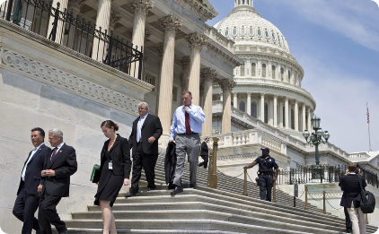
Introduction to Lobbying
The Art of Lobbying
What's at Stake?
Exercising Free Speech
Lobbying refers to the act of influencing key policymakers at the local, state and federal levels of government. Lobbyists do so by taking a stance on issues that align with the client’s goals and persuade decisionmakers to support those goals.
Lobbying can impact legislation, public policies, and regulations, leading to changes that can have a significant impact on individuals, organizations, and even entire industries.
While lobbying can sometimes carry a negative connotation, it is a constitutionally protected right. It can make a meaningful difference in how decisions are made.

Slide 3
The Purpose and Goals of Lobbying
Influence Decision-Making
Represent Interests
Educate and Inform
Lobbyists represent, advocate, and promote the interests of individuals, organizations, or causes. They bridge the gap between government officials and their clients, working to achieve mutually beneficial outcomes.
Lobbyists provide policymakers with information and data about relevant issues, trends, and concerns. They help lawmakers make more informed decisions based on evidence and research.
The goal of lobbying is to influence policymakers and persuade them to take a particular course of action. It can range from implementing new policies to defeating proposed regulations or legislation.

Slide 4
The Process of Lobbying
1
Identify the Client
Before beginning the lobbying process, it's important to identify the client's interests and objectives.
Target Audience
2
Once the client's goals are defined, lobbyists identify the key lawmakers, officials, or decision-makers who need to be persuaded.
3
Strategy and Tactics
Lobbyists carefully design a comprehensive strategy that includes persuasion tactics, such as public relations campaigns, grassroots activism, and direct lobbying efforts.
Building Relationships
4
Relationship building is critical to successful lobbying. This involves establishing and maintaining connections with government officials, staffers, and stakeholders.

Slide 5
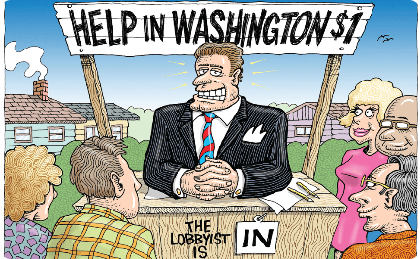
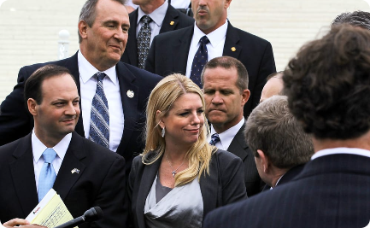
Techniques Used in Lobbying
Public Relations
Grassroots Activism
Direct Lobbying
Public relations tactics like creating campaigns, advertisements, and promotional material can help promote the client's position on a particular issue.
Lobbyists can also mobilize citizens, supporters, or advocates to promote a position or sway policymakers. It can include letter-writing campaigns, petitions, and social media activism.
In-person meetings between lobbyists and policymakers can also be effective. This can include sponsored events, personal meetings, and discussions.

Slide 6
The Impact of Successful Lobbying
Legislation and Policy Changes
Increased Profits and Revenue
Successful lobbying can result in legislative changes or new policies that benefit clients and specific interests.
Effective lobbying can have a big payoff for clients. It can lead to increased profits, earnings, or revenue.
New Business Opportunities
Expanded Influence
New policy changes or legislative initiatives can open up new business opportunities that clients can take advantage of.
Lobbying can also increase the influence and reach of clients and promote their messages to a wider audience.

Slide 7
Examples of Successful Lobbying
Real-life examples of successful lobbying efforts that have resulted in significant policy changes and advancements in various industries. Discover how effective lobbying can shape legislation and influence decision-making processes.

Slide 8
Tobacco Cessation and Control
The Tobacco Master Settlement Agreement was a groundbreaking outcome led by state attorneys general that resulted in billions of dollars in compensation from tobacco companies and significant public health reforms. This landmark agreement has continued to shape tobacco regulation and influence future lobbying strategies.

Slide 9
The Clean Air Act Amendments of 1990
Public health groups like the American Lung Association and the American Cancer Society were behind the Clean Air Act Amendments of 1990, which aimed to reduce air pollution and protect public health. This legislation transformed environmental regulations and paved the way for cleaner air and improved quality of life. This legislation set the stage for similar state and local legislation. In AZ, public health groups influenced the Passage of the Smoke Free AZ Act, which is still being debated today.

Slide 10
Controversies Surrounding Lobbying
1
Money and Influence
2
Lack of Transparency
It's no secret that lobbying can be expensive. Critics argue that it gives those with more money and power an undue influence over policymaking.
Opponents claim that lobbying is carried out behind closed doors and lacks transparency. It can be difficult to track the flow of money, the interests at play, or the actual contents of proposed legislation.
3
Conflicts of Interest
There are concerns that some lobbyists may have conflicts of interest that could compromise their ability to represent their clients or influence policymaking in a balanced and fair manner.

Slide 11
The Benefits of Lobbying for Businesses, Industries, Local Government, and Non-Profits
Lobbying can provide valuable advocacy and representation for businesses, industries, local government, and non-profits. It can help shape policies, secure funding, and influence decision-making processes. Effective lobbying strategies can lead to positive outcomes and create opportunities for growth and success.

Slide 12
Conclusion and Call to Action
Lobbying is an essential component of our political system that allows citizens and organizations to influence the government to represent their interests. However, to ensure a fair and transparent process, we must remain vigilant and ensure our laws work for everyone.

Slide 13
With over 15 years of experience in law and government relations, Liz combines big-picture vision with intellect and attention to detail to build teams, effect change, and ultimately reach her clients’ goals, whether incremental or monumental. She believes that civil discourse is the key to sound policy solutions and prides herself on the ability to find connection and common ground across divides. Her record speaks for itself, having secured numerous legislative victories for vastly unique clients. Her proudest victories include securing a statewide college tuition waiver for children in foster care and championing legislation that reduces the prevalence of surprise out-of-network billing practices.
Elizabeth Goodman
Managing Principal
Husch Blackwell Strategies Phoenix Email: egoodman@hbstrategies.us
Liz holds a J.D. from Albany Law School, where she developed an interest in public health and policy through her work serving clients living with terminal illnesses and representing inmates in civil suits, often involving access to health care. Her policy expertise was honed while serving as Counsel in the New York State Senate and then as Staff Attorney at the Arizona House of Representatives, where she advised policymakers on a full range of issues including child welfare, domestic relations, health, and criminal justice reform. Liz was part of the bipartisan group of advisors responsible for shepherding Medicaid expansion through the Arizona Legislature and was among the team of aides who negotiated the terms of the new Department of Child Safety, Arizona’s revamped child protection agency.

