Slide 1
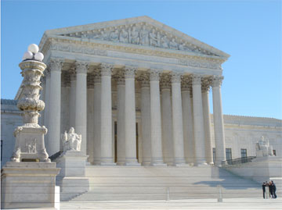
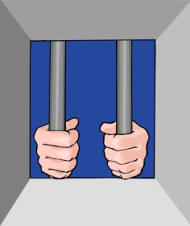
COERCION
CORNER
Jackson
v.
Denno
Mincey v. AZ
The Temple of Doom!
NAME THAT CASE
SPACE
city
Suppression
City
Suppression
City
IMPORTANT CASE SPACE:
Thompson
v.
Keohane
PICK A MIRANDA CARD
IMPORTANT CASE SPACE:
Oregon
v.
Elstad
Pick a Voluntariness Card
In Custody Space
MIRANDA LAND
Non-Trivial Legal Pursuit
IMPORTANT CASE SPACE:
Harris
v.
New York
In Custody Space
Pick a Voluntariness Card
IMPORTANT CASE SPACE:
Colorado
v.
Connelly
A GAME ABOUT THE RIGHT TO REMAIN SILENT
IMPORTANT CASE SPACE:
Edwards
v.
Arizona
COERCION CORNER
Townsend
v.
Sain
Non-Trivial Legal Pursuit
IMPORTANT CASE SPACE;
Brown
v.
Mississippi
NAME THAT CASE
SPACE
IMPORTANT CASE SPACE:
Berghuis
v.
Thompkins
Miranda
Strategy
PICK A MIRANDA CARD
Voluntariness Strategy
In Jail

Slide 3
Miranda Rights
You have the right to remain silent.
Anything you say can and will be used against you in a court of law.
You have the right to the presence of an attorney prior to questioning, and to have an attorney present with you during questioning if you so desire
If you cannot afford an attorney one will be appointed for you prior to any questioning if you so desire. Miranda v. Arizona, 384 U.S. 436, 479 (1966).

Slide 4
Fully Effective Equivalent
The warnings required and the waiver necessary in accordance with our opinion today are, in the absence of a fully effective equivalent, prerequisites to the admissibility of any statement made by a defendant. Miranda v. Arizona, 384 U.S. 436, 476, 86 S. Ct. 1602, 1629, 16 L. Ed. 2d 694 (1966)

Slide 5
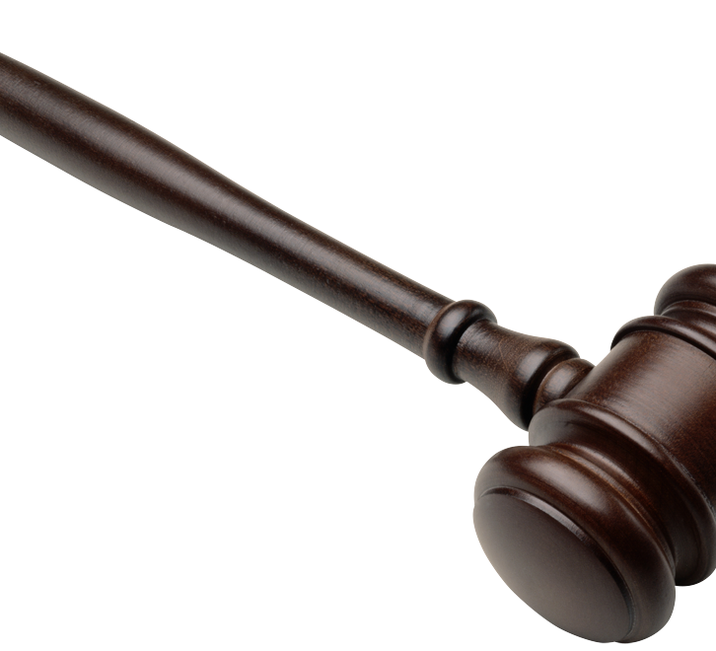
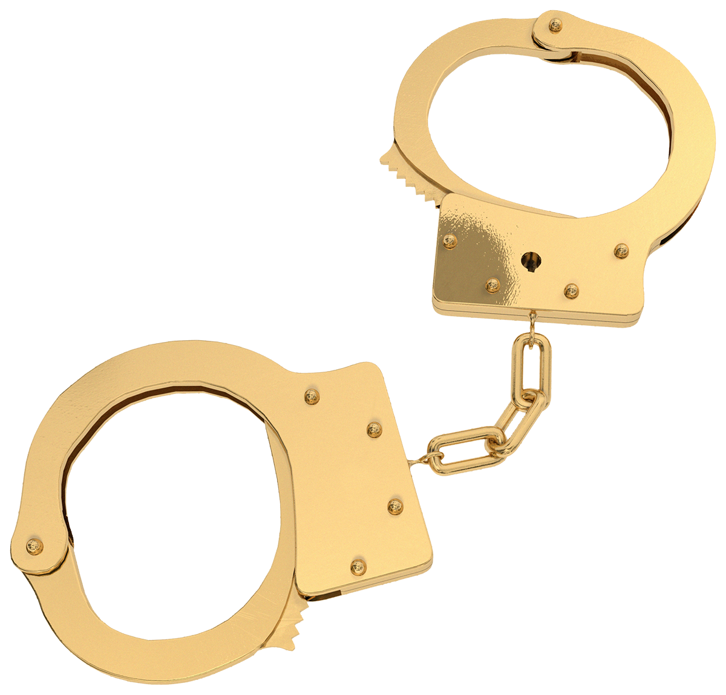
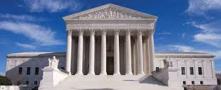
Miranda Land’s Cast of Characters

Slide 6
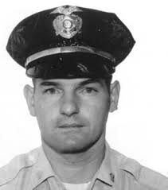
The Cop
Carroll Cooley

Slide 7
Miranda – Requires a Cop Dominated Atmosphere
The constitutional issue we decide in each of these cases is the admissibility of statements obtained from a defendant questioned while in custody or otherwise deprived of his freedom of action in any significant way. In each, the defendant was questioned by police officers, detectives, or a prosecuting attorney in a room in which he was cut off from the outside world. In none of these cases was the defendant given a full and effective warning of his rights at the outset of the interrogation process. In all the cases, the questioning elicited oral admissions, and in three of them, signed statements as well which were admitted at their trials. They all thus share salient features—incommunicado interrogation of individuals in a police-dominated atmosphere, resulting in self-incriminating statements without full warnings of constitutional rights. Miranda v. Arizona, 384 U.S. 436, 445, 86 S. Ct. 1602, 1612, 16 L. Ed. 2d 694 (1966).

Slide 8
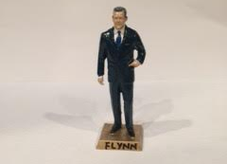
John Flynn

Slide 9
Flynn Facts
Born in Tortilla Flats Arizona.
His father was a union organizer who served prison time for cattle rustling.
Joined the Marine Corps at 17 & wounded in the Pacific during WWII. Awarded the Silver Star.
Argued State v. Treadway
Said to have tried over 125 Murder Trials

Slide 10
The Emotional Propensity Exception To The General Rule that Other Crimes Are Inadmissible holds that evidence of prior sexual misconduct may be admissible to prove the accused's propensity to commit the sexual offense charged if the prior misconduct happened close in time to the alleged crime, was similar in nature to it, and involved an abnormal sexual acts. State v. McFarlin, 110 Ari. 225,228 (1973).
Treadway held that prior sexual conduct occurring three years in the past was too remote for admission pursuant to the emotional propensity exception in a sodomy trial in the absence of expert medical testimony that that such a prior act tends to show a continuing emotional propensity to commit the crime charged. State v. Treadway, 116 Ariz. 163, 167, 568 P.2d 1061, 1065 (1977)
State
v.
Treadway

Slide 11
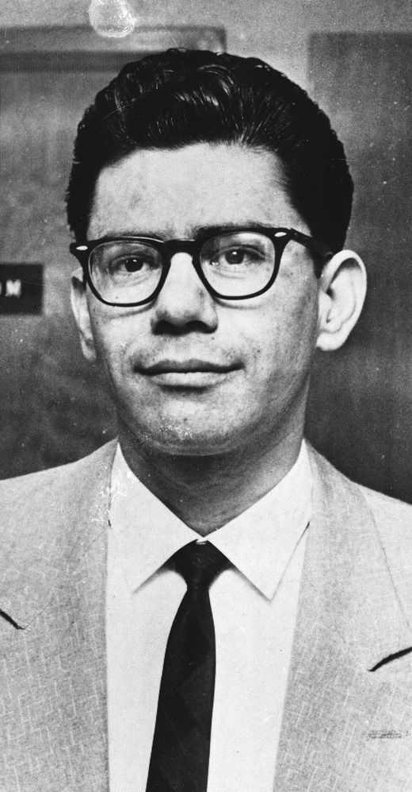
Ernesto Miranda

Slide 12
Ernesto Miranda
He was 23 years old at the time his 5th Amendment Rights were violated.
John Flynn describes him before the Supreme Court as:
“ Spanish-American extraction.”
“a man of limited education”
“mentally abnormal”
“certainly indigent”

Slide 13
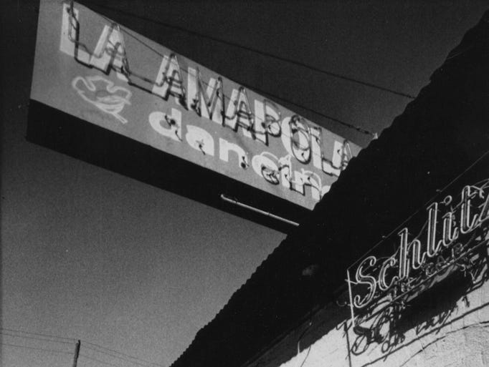
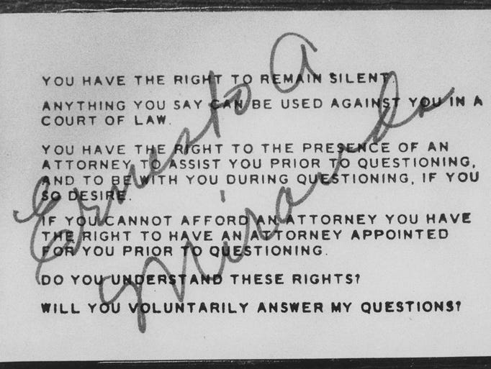
He was stabbed to death at the Amapoloa Bar. His attackers were read their Miranda Rights and invoked.

Slide 14
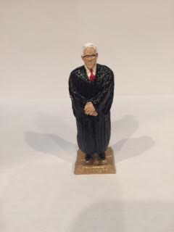
Earl Warren

Slide 15
Chief Justice Earl Warren
Prior to joining the Supreme Court
Was an Alameda County California Prosecutor & District Attorney for a number of years.
His elderly father was bludgeoned to death.
Police officer from all over the State of California volunteered to assist in the murder investigation.
A progressive Republican who served 3 terms as the governor of California.
Made a backroom deal with Eisenhower people at the 1954 Republican National Convention.

Slide 16
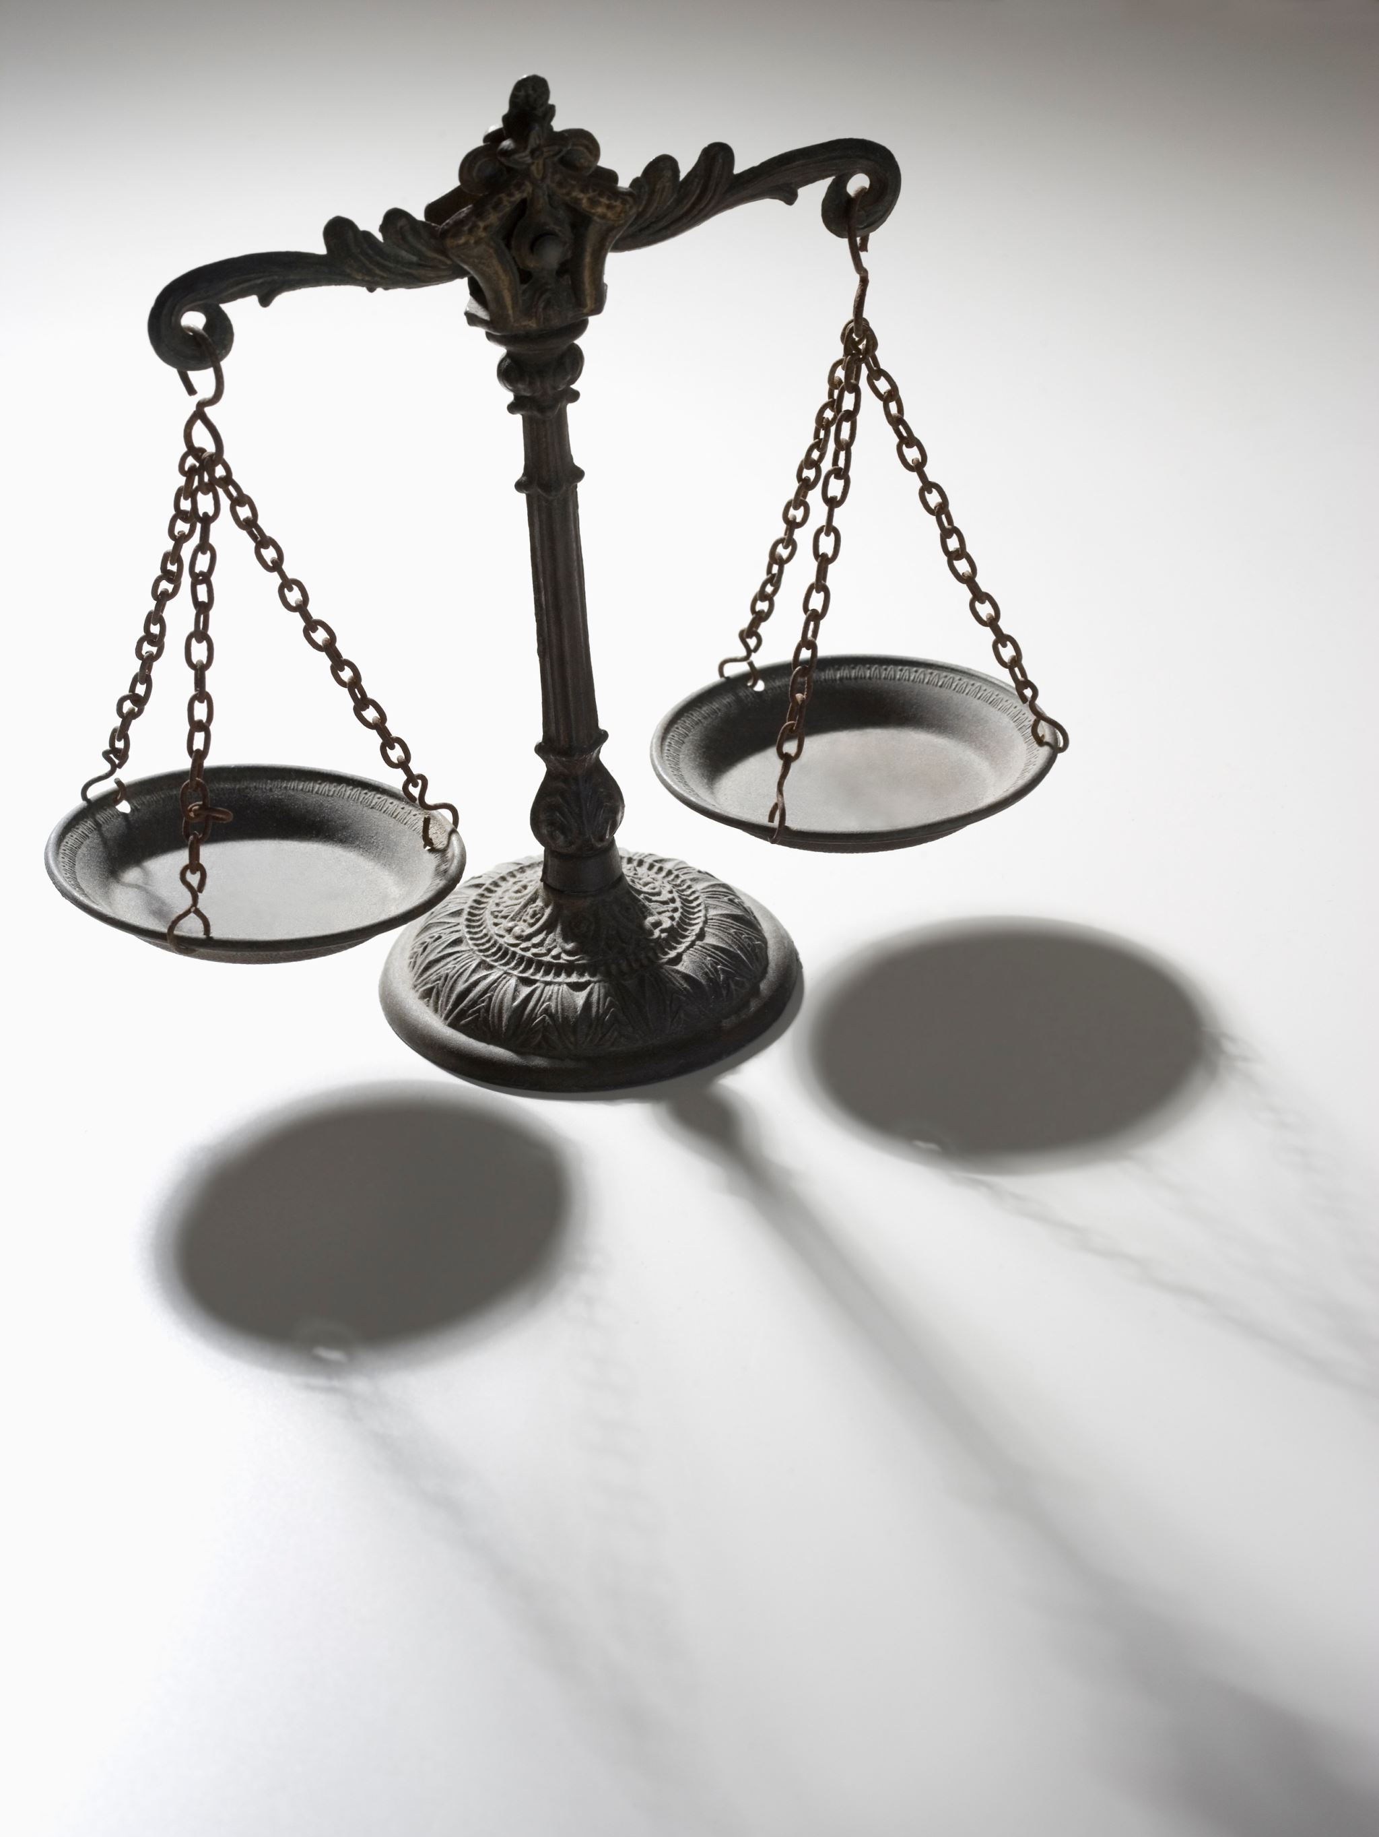
Warrens grounds the Miranda decision in Indigent Connection Roots
“If an individual indicates that he wishes the assistance of counsel before any interrogation occurs, the authorities cannot rationally ignore or deny his request on the basis that the individual does not have, or cannot afford, a retained lawyer. The financial ability of the individual has no relationship to the scope of the rights involved here. The privilege against self-incrimination secured by the Constitution applies to all individuals. The need for counsel in order to protect the privilege exist for the indigent as well as the affluent. In fact, were we to limit these constitutional rights to those who can retain an attorney, our decision today would be of little significance. The cases before us, as well as the vast majority of confession cases with which we have dealt in the past involve those unable to retain counsel. While authorities are not required to relieve the accused of his poverty, they have the obligation not to take advantage of his indigence in the administration of justice. Denial of counsel to the indigent at the time of interrogation while allowing an attorney to those who can afford one would be no more supportable by or logical than the similar situation at trial and on appeal struck down by Gideon v. Wainwright.” Miranda, at 472-473.

Slide 17
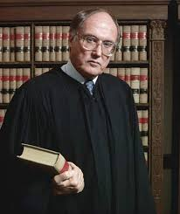
William H. Rehnquist

Slide 18
William Rehnquist sent a memorandum to the Associate Deputy Attorney General in regard to the Miranda decision:
“there is reason to believe the Warren court has tilted the scales of justice too far in favor of criminal suspects.” He recommended in his memo that the president appoint a national commission “to determine whether the overriding public interest in law enforcement requires a constitutional amendment.” He said, “The court is now committed to the proposition that relevant, competent un-coerced statements of the defendant will not be admissible unless an elaborate set of warnings be given, which is very likely to have the effect of preventing a defendant from making any statements at all.” At another point in the memo, Rehnquist talked about the court “believing that the poor disadvantaged criminal defendant should be just as aware of incriminating himself as the rich, well rounded criminal defendant, the court has undoubtedly put an additional hurdle in the way of convicting the guilty.”

Slide 19
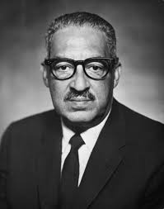
Thurgood Marshall

Slide 20
Berkemer v. McCarty, 468 U.S. 420 (1984)
In the decision the court discusses factors involving a routine traffic stops which it uses to distinguish such stops from custodial interrogation: 1) traffic stop are presumptively temporary and brief; 2) a motorist expectations when he sees police lights flashing are that he will be obliged to spend a short amount of time answering questions and waiting while the officer checks his license and registration; 3) a motorist has an expectation that he may be given a ticket; 4) a motorist views traffic stop questioning differently from jail house interrogations which are long and continue until the interrogator is provided with the answer sought after; and 5) the typical traffic stop is public, and therefore “reduces the ability of the unscrupulous policeman to use illegitimate means to illicit self-incriminating statements” and the public view “diminishes the motorist fear that, if he does not cooperate, he will be subjected to abuse.” At 439. The court opined that the factors common to a routine traffic stop make it “substantially less police dominated” than the atmosphere in Miranda. At 439. Miranda is implicated when “a suspect’s freedom of action is curtailed to a “degree associated with formal arrest.” At 440. (Internal citation omitted).

Slide 21
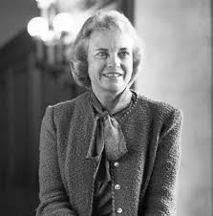
Sandra Day O’Connor

Slide 22
The Two Step-Interrogation Process
Facts: Eighteen-year-old Elstad was arrested in his home for burglary, was briefly interrogated and gave an un-Mirandized incriminating statement. He was taken to the police station and an hour later was Mirandized and then confessed. Officers subsequently typed up the confession and Elstad signed it. His lawyer argued the second Mirandized statement was involuntary because, the first un-Mirandized statement “let the cat out of the bag.”
Holding: The Supreme Court held that “[T]he relevant inquiry is whether, in fact, the second statement was also voluntarily made. At any such inquiry, the finder of fact must examine the surrounding circumstances and the entire course of police conduct with respect to the suspect in evaluating the voluntariness of the statement.” At 318. The Court also stated that the Fourth Amendments Fruits Doctrine does not apply to Miranda.

Slide 23
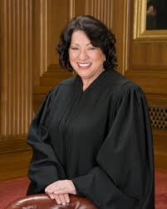
Sonia Sotomayor

Slide 24
J.D.B. v. North Carolina, 131 S. Ct 2394(2011)
Facts: Defendant was a 13-year-old 7th grader attending middle school when he was removed from his classroom by a uniformed police officer, escorted to a closed-door conference room, and questioned by police for at least a half hour about residential burglaries. At the start of questioning the 13-year-old was not given Miranda warnings, the opportunity to speak to his grandmother (his legal guardian), nor was he informed he was free to leave.
Issue: Is the age of child subjected to police questioning relevant to the custody analysis?
Holding: The Supreme Court held that that a child’s age properly informs the Miranda custody analysis.

Slide 25
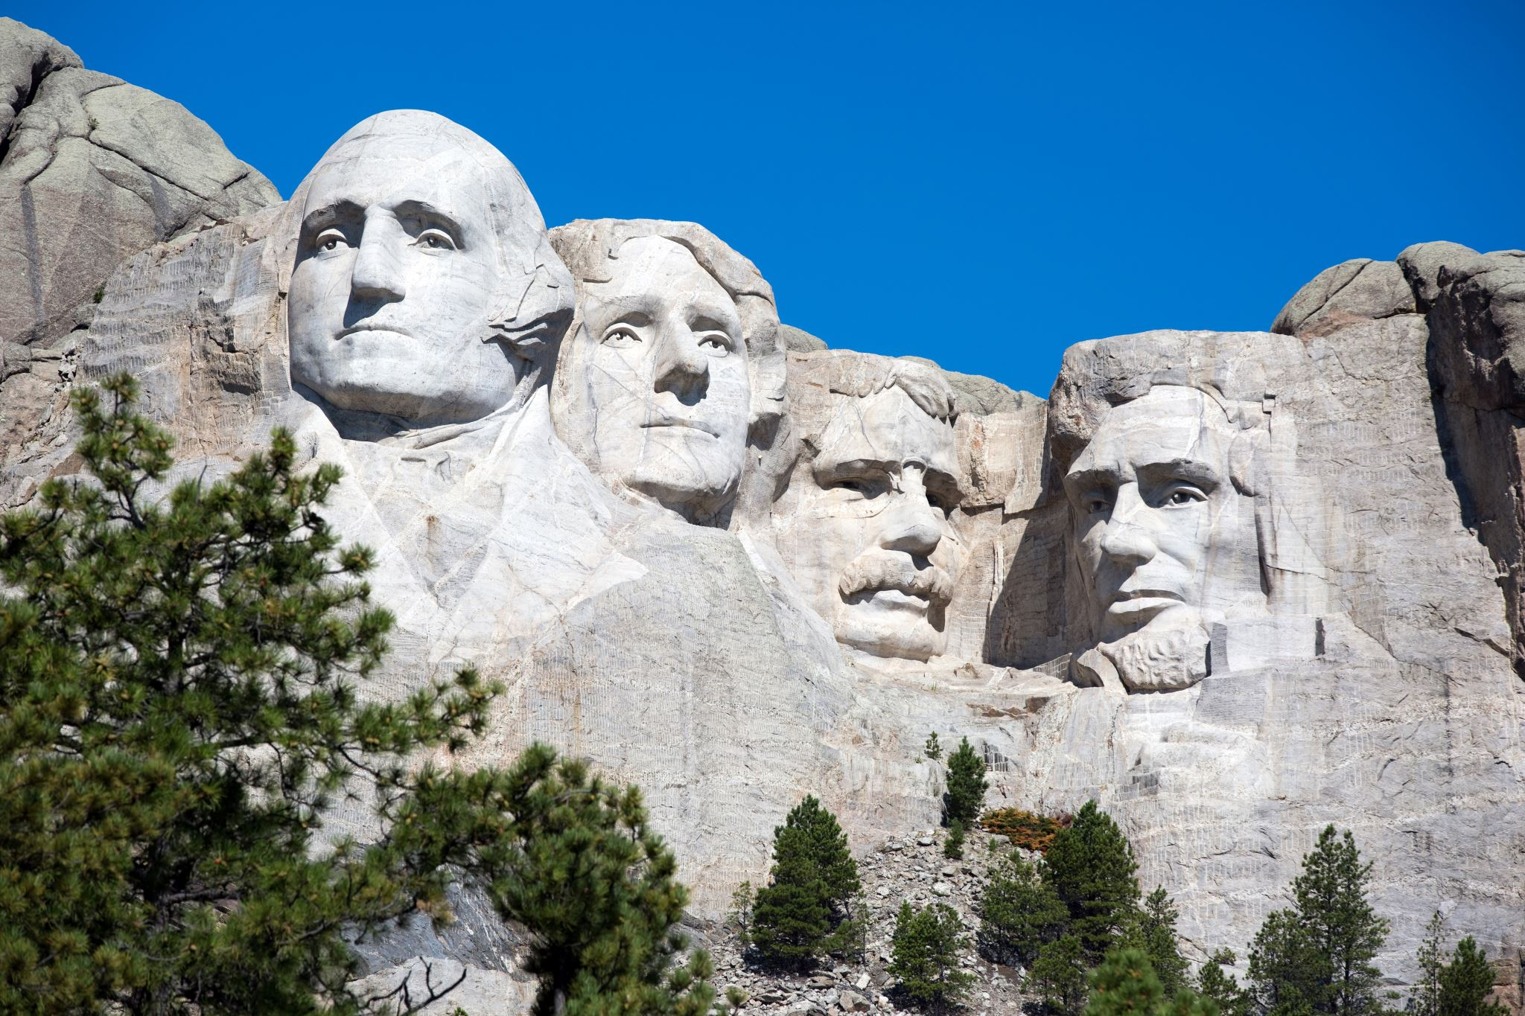
Rhenquist’s Redemption –Dickerson v. United States, 530 U.S. 438 (2010)

Slide 26
Rhenquist’s Redemption
“We do not think there is such justification for overruling Miranda. Miranda has become embedded in routine police practice to the point where the warnings have become part of our national culture.” Dickerson v. United States, 530 U.S. 428, 443 (2000).
“In sum, we conclude that Miranda announced a constitutional rule that Congress may not supersede legislatively. Following the rule of stare decisis, we decline to overrule Miranda…” Id. at 444.

Slide 27
Jerry Schreck
602-370-3262
Jerry@schrecklawfirm.com

