Slide 1
My (current)Top Ten Do’s and Don’ts – subject to change ☺
Judge Frank W. Moskowitz
Maricopa County Superior Court

Slide 2
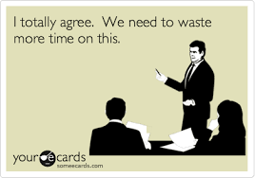
Proposed orders
DO
DON’T
include the new date, deadline, and any other specific information that you want in the proposed order. If the Judge wants to modify the proposed order, they can do so.
include “[Proposed],” leave blanks (unless you have good reason), use conclusory, non-specific language (i.e., “may serve by alternative service” with nothing more), or “HEAR YE, HEAR YE” type language, reference an incorrect associated filing, or include a certificate of service – doing so just forces the Judge to take the time to modify an order that may not otherwise need to be modified. Again, if the Judge wants to modify the proposed order, they can do so.

Slide 3
Motions
DO
DON’T
make it easy for the Court to give you what you want - show your work – succinctly state at the beginning what you are asking for and why you are entitled to or should get the relief you are requesting. More is generally not better, unless there is good reason (i.e., to make a record).
make it difficult for the Court to figure out the relief you are requesting and the factual and legal basis for same.

Slide 4
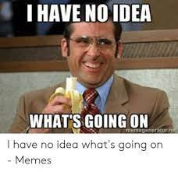
Expedited consideration/relief
DO
DON’T
email a copy of your filed request to the Judicial Assistant; otherwise, it may be days before it gets to the Judicial Assistant via e-file.
forget to advise the Court in your filing about the other side’s position or your attempt to get their position before you filed.

Slide 5
Oral argument
DO
DON’T
ask the Court if they have any questions or would like you to focus on a specific subject before you begin your argument.
just regurgitate your written work product and don’t be afraid to concede facts or law that may not support your position. It actually makes you more credible and perhaps what you are conceding is not entirely material or dispositive.
Open

Slide 6
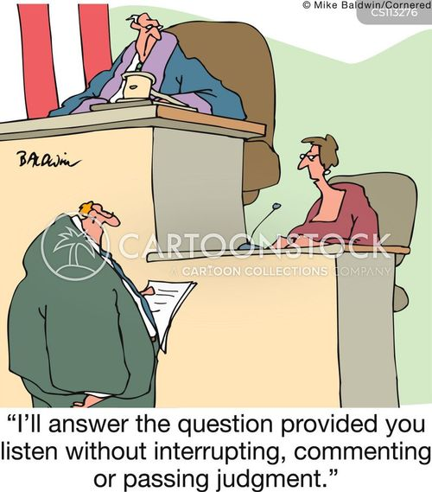
Cross-Examining witnesses
DO
DON’T
listen carefully to the answers given on direct exam and if you have what you need, consider not standing up for cross. If you stand up for cross, once you have the facts you need strongly consider sitting down. If a witness is being difficult, ask the Court for assistance.
argue with a witness, repeat the same questions, or ask questions simply because you think you have to, and don’t try to present your entire case though one witness. Know what facts you need from each witness for your closing argument, get them and sit down.

Slide 7
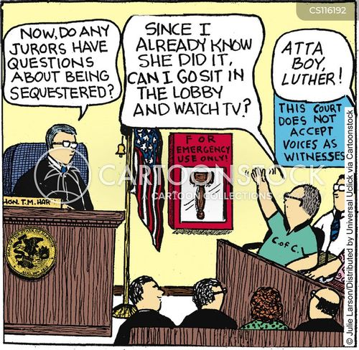
Voir dire (Jury Selection)
DON’T
DO
consider using written juror questionnaires, especially now that there are no longer preemptory strikes.
forget to follow up and speak with potential jurors. Would you hire someone based solely on their resume and other written product?

Slide 8
Notice of Extensions and settlement
DO
DON’T
promptly notify the Court if you have agreed to give the other side an extension to a motion or settled the case.
wait to inform the Court that your case settled until after the Court has spent the time ruling on a pending MSJ (work that was completely unnecessary) or make the Court’s staff email you to find out if you have agreed to an extension for a response or reply regarding a pending motion.

Slide 9
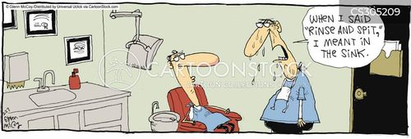
Court staff
DO
DON’T
be respectful to court staff.
forget that what you say and how you treat them is often relayed to their assigned Judicial Officer

Slide 10
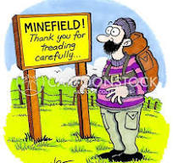
Minute entries
DO
DON’T
read them carefully and come to the scheduled hearing prepared to address the matters the Court has specifically identified in the Minute Entry.
forget to look for a “LATER” at the end of a Minute Entry.

Slide 11
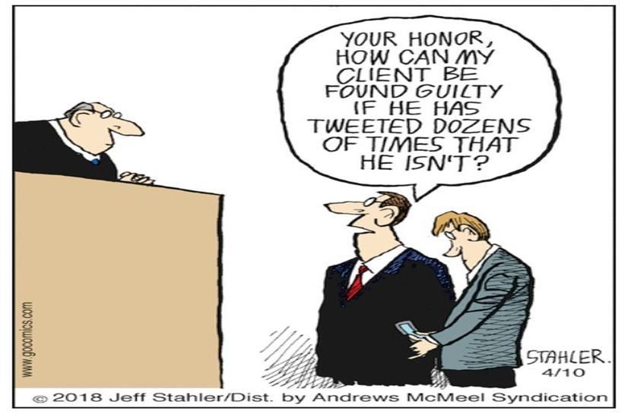
Voice of reason
DO
DON’T
be that.
bank on a “aha, gotcha” moment or a form over substance strategy.

Slide 12
THANK YOU
*These were simply some tips, suggestions, and opinions of one humble Judge and not those of the entire bench.

