Slide 1
Contemporary Issues In IP Law
Presented by Michelle L. Gross
October 24, 2025
© 2025

Slide 2
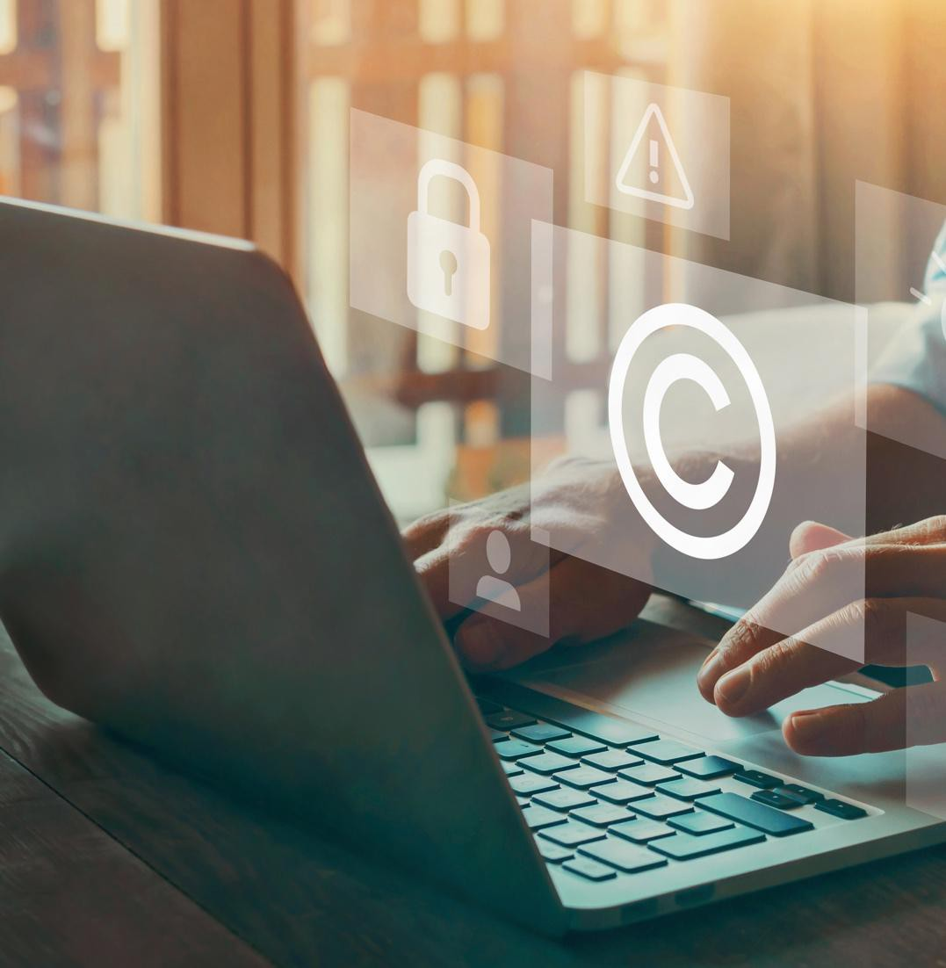
Copyright , Fair Use, & AI
What is a copyright?
The exclusive right to copy, modify, distribute, publicly display or publicly perform a work of authorship
What is eligible for copyright protection?
Any minimally creative work of authorship “fixed in a tangible medium” of expression
Only protects the form of expression (e.g., selection and ordering of text, sounds, shapes, colors, etc.)

Slide 3

Copyright Infringement
Violating exclusive rights
Exercising any of the copyright owner's exclusive rights without permission, including the right to reproduce the work, prepare derivative works, distribute copies, perform the work publicly, or display the work publicly.
Strict liability
Intent is not necessary.
Using a copyrighted work without permission can result in liability, regardless of whether you knew it was copyrighted or intended to infringe.
Access and copying
To prove infringement, it is generally required to show that the alleged infringer had access to the original work and that the work is substantially similar.

Slide 4
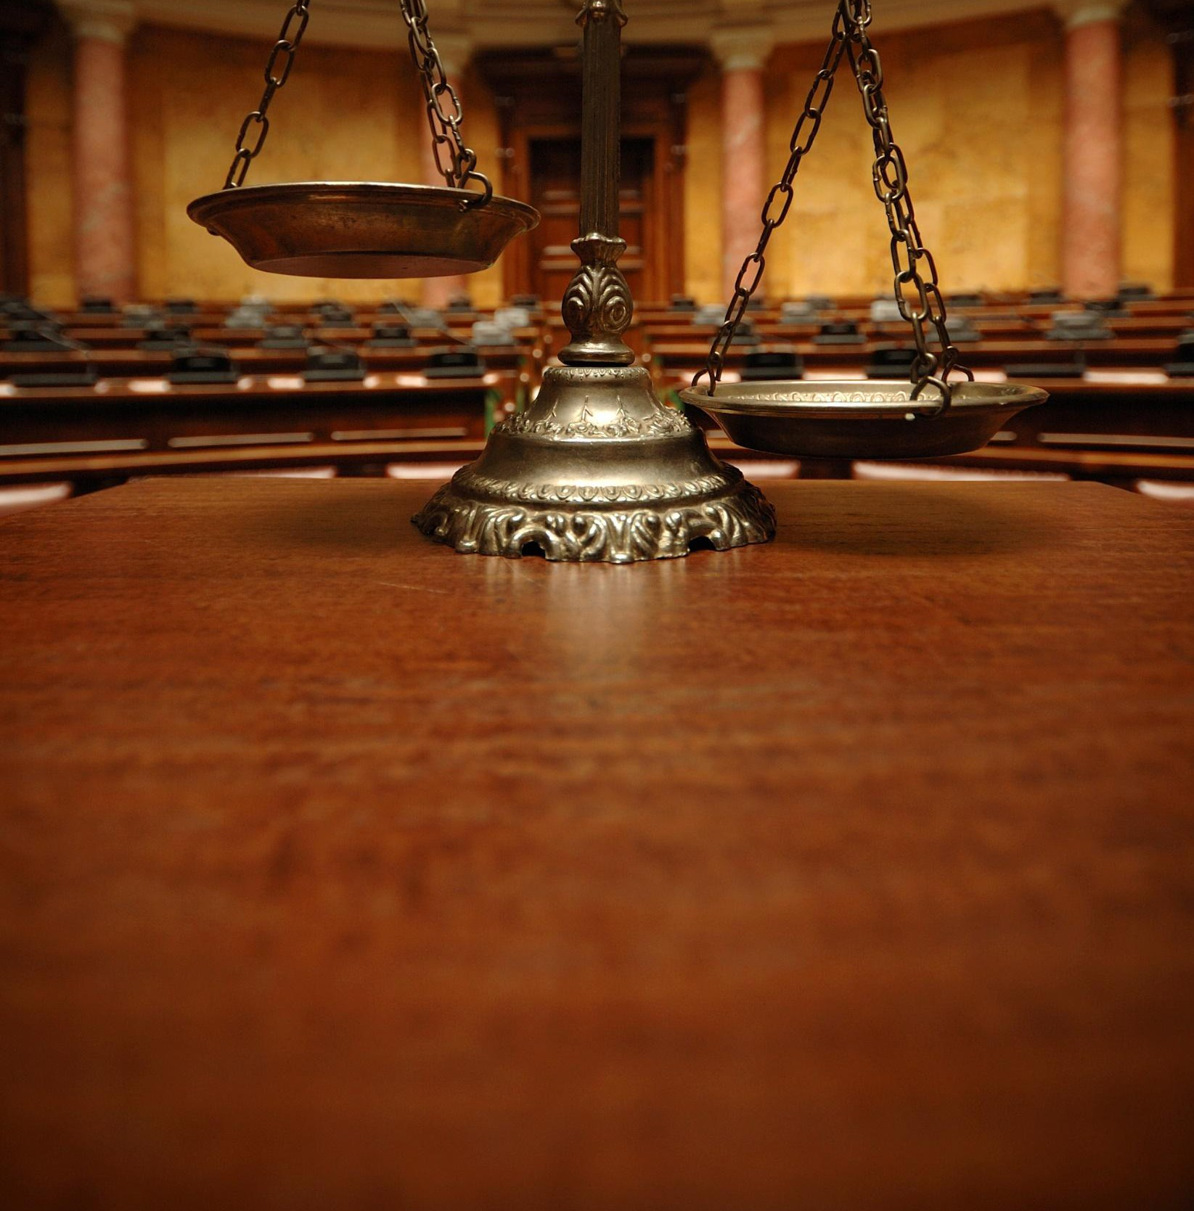
GenAI Lawsuits – Sample Issues
Copyright Infringement
Training AI models
Infringing outputs
Open-Source code generator
DMCA violation – removal of Copyright Management Information (CMI)
OS license compliance
AI Authorship
Most lawsuits have been filed against tool providers – users will start getting sued next

Slide 5
Copyright Issues with Training AI Models
• Is copying content to train AI models infringement?
• Does copying itself constitute infringement or is it protected intermediate copying?
• Must there be infringing output?
• What if output is not (substantially) identical?
• When might it be a derivative work?
• If infringement, is fair use a defense?
• If infringement who is liable?

Slide 6
Copyright Issues with Training AI Models
The answers depend on the facts of each case
Content types
Content sources (e.g., is it a licensed or otherwise permitted use)
How training is performed (it varies)
The purpose for use
Prediction: There will not be a per se rule – each case will turn on its facts

Slide 7
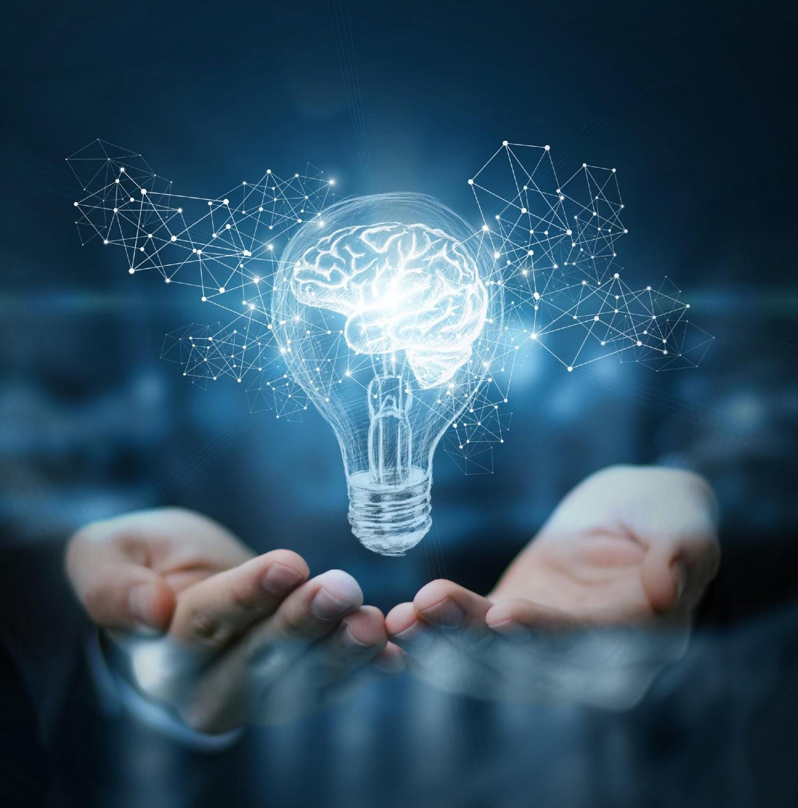
Fair Use
Permits the limited use of copyrighted material without acquiring permission from the rights holders for purposes like criticism, comment, news reporting, teaching, scholarship, or research.
Subjective analysis
Better to get permission

Slide 8
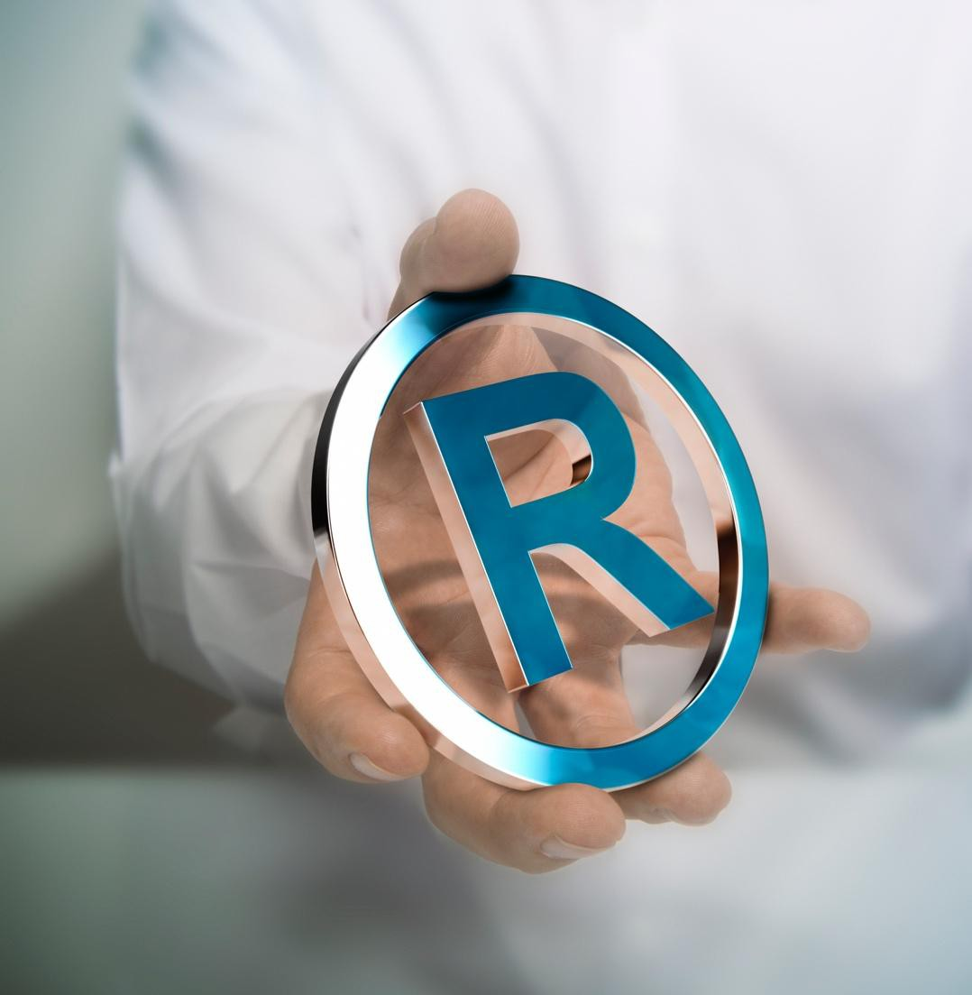
4 Factor Fair Use Test
The purpose and character of the use
Commercial nature or is for non-profit educational purposes?
Is it transformative?
The nature of the copyrighted work
Factual vs. highly creative or fictional
The amount and substantiality of the portion used in relation to the copyrighted work as a whole
Using “heart” of the work, even if small, weighs against fair use
The effect of the use upon the potential market for or value of the copyrighted work

Slide 9
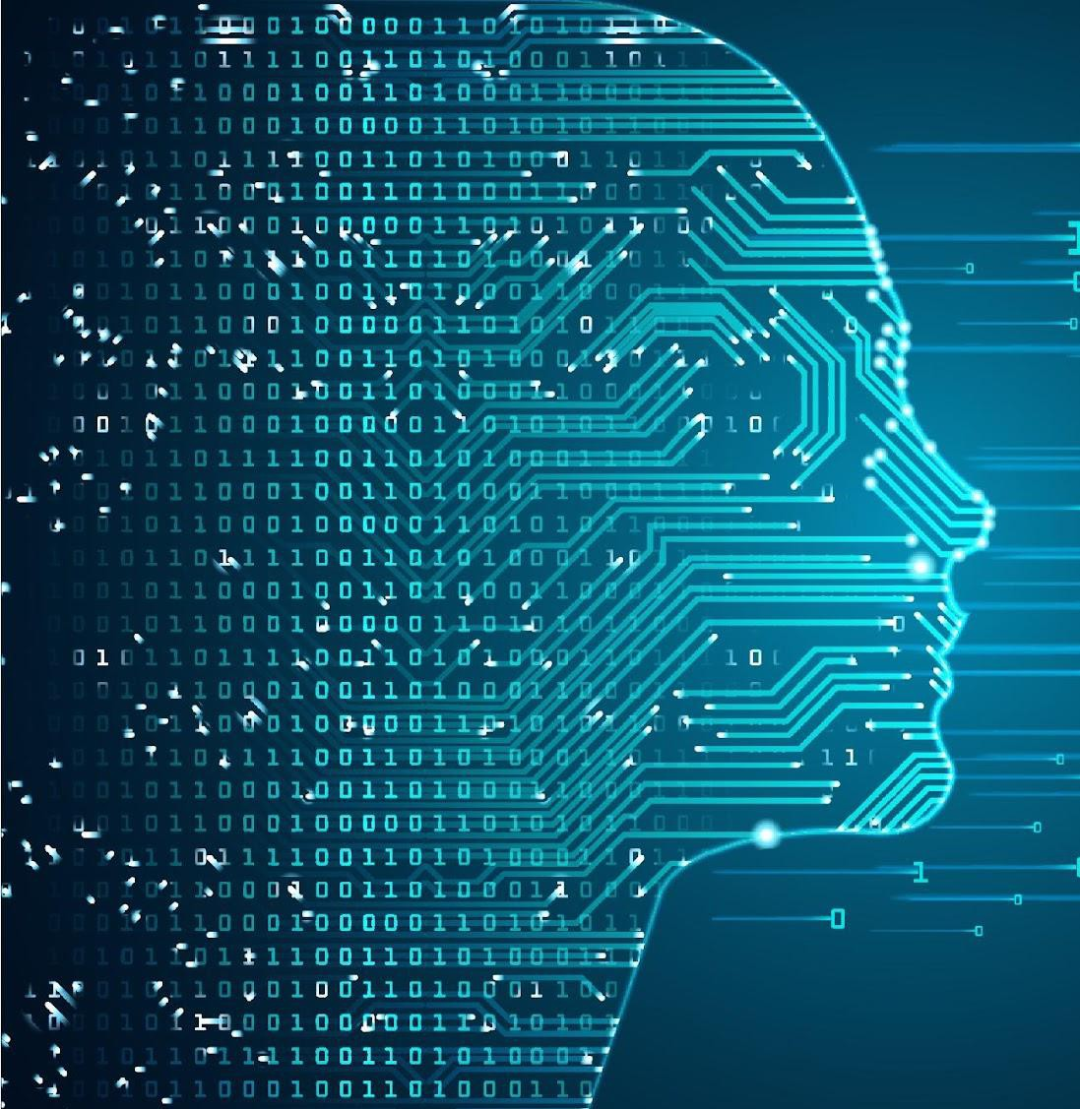
How is AI Trained?
Often content is copied but transformed
Training data is tokenized (e.g., converted to numerical parameters)
Embeddings involve the model learning information from the datasets as the training occurs
A mathematical representation of a set of data that captures underlying relationships and patterns in the data
Model may not include a copy of the content

Slide 10
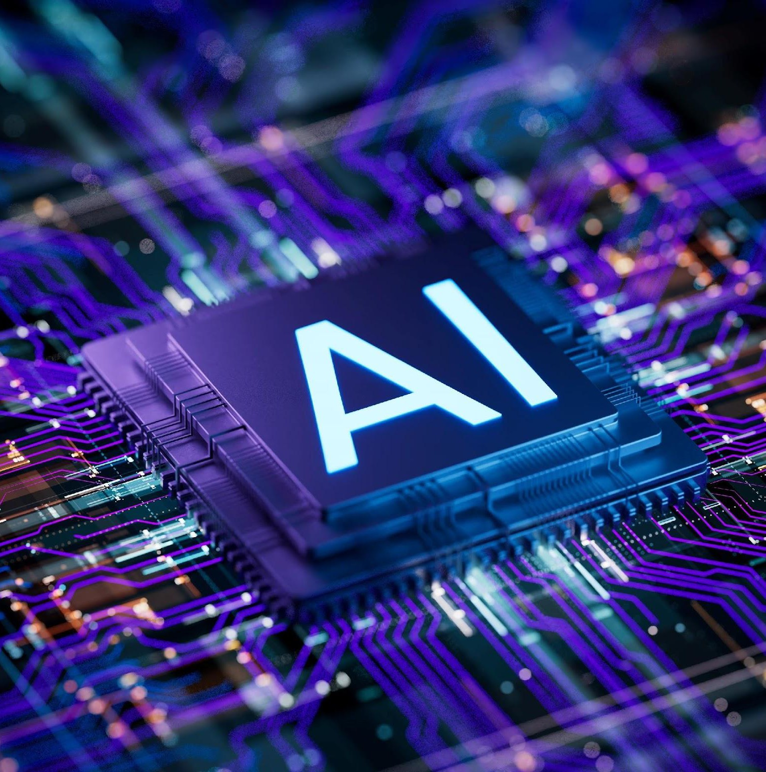
Transformation of Form vs. Purpose
• Derivative works include transformation of form (e.g., translation of a novel into another language, the adaptation of a novel into a movie or play, or the recasting of a novel as an e-book or an audiobook)
• By contrast, copying for the purpose of criticism or commentary on the original or provision of information about it (e.g., extracting info from content) or for other purpose tends to
satisfy the notion of a “transformative” purpose involved in the analysis of the first factor of the fair use test.

Slide 11
Transformation of Form vs. Purpose
• HathiTrust, 755 F.3d at 97–98 (2d Cir.2014) (justifying as transformative fair use purpose the digital copying of original for purpose of permitting searchers to determine whether its text employs particular words)
• A.V. ex rel. Vanderhye v. iParadigms, LLC, 562 F.3d 630,
638–640 (4th Cir.2009) (justifying as transformative fair use
purpose the complete digital copying of a manuscript to
determine whether the original included matter plagiarized
from other works)
• Perfect 10, Inc. v. Amazon.com, Inc., 508 F.3d 1146, 1165 (9th
Cir.2007) (justifying as transformative fair use purpose the
use of a digital, thumbnail copy of the original to provide an
Internet pathway to the original)

Slide 12
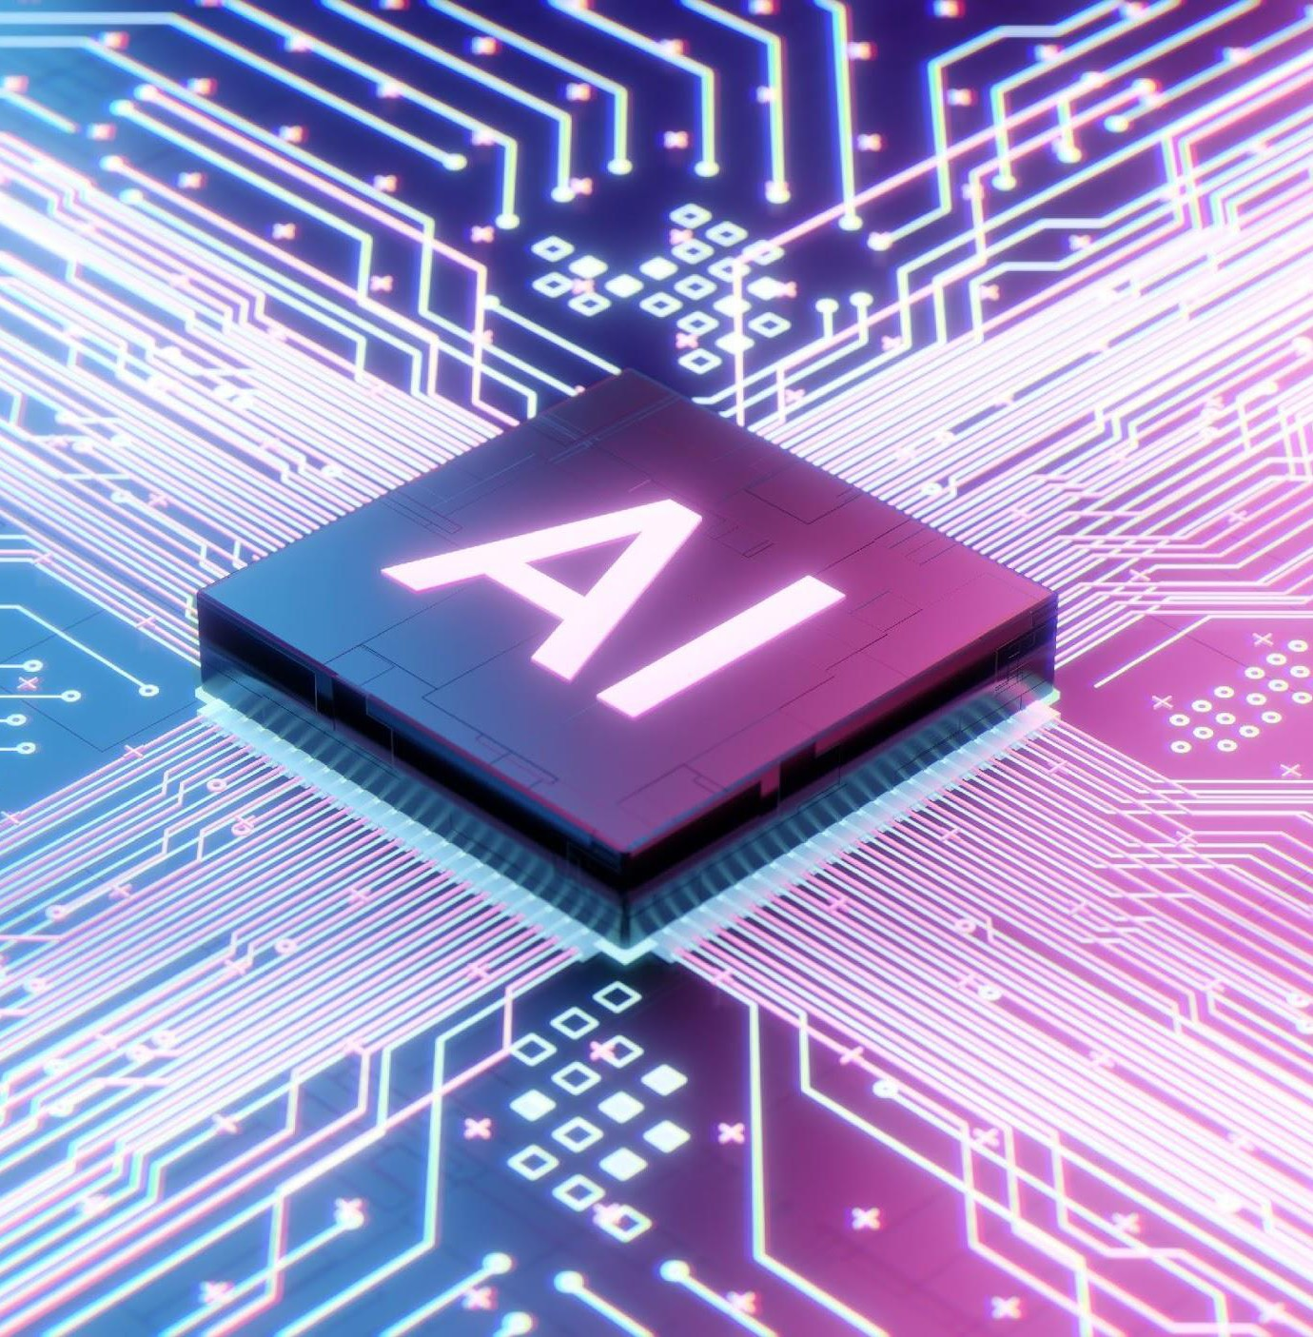
Authors Guild v. Google (“Google Books”)
• Google scanned and digitized printed, copyrighted books into an online searchable database/index; only provided "snippet views" of the scanned pages in search results to users
• District Court (SDNY) granted summary judgement in favor
Court denied cert.
• Google provides a public service without violating intellectual property law. Scanning and computer-aided recognition for searching online was a transformative purpose
• No adverse impact on market for books; actually helps market
of Google, finding fair use.
2nd
Circuit affirmed. Supreme

Slide 13
Ebooks Case
• Hachette Book Group, Inc. v. Internet Archive, 664 F.Supp.3d 370 (S.D.N.Y. 2023)
• Created National Emergency Library (NEL) during the onset of
the COVID-19 pandemic – scanned books to create eBooks as part of
controlled lending program (either physical version or digital at one
time)
• Copyright infringement and no fair use – no transformative purpose and impacted commercial market

Slide 14
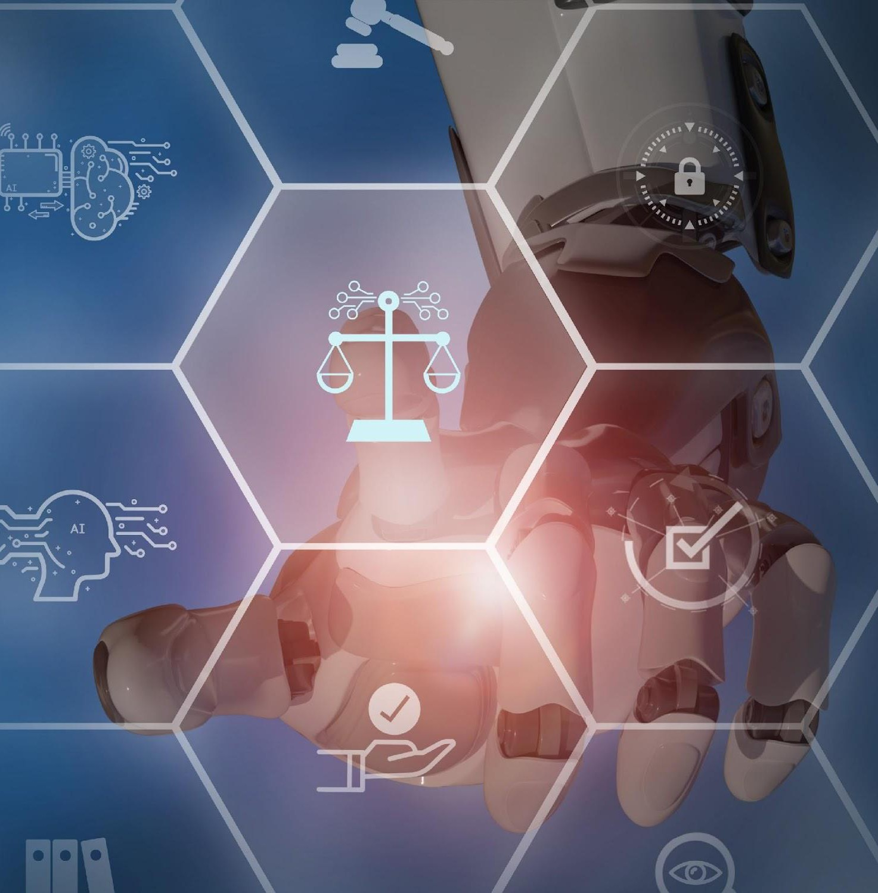
Thomson Reuters v. Ross
• Ross copied legal headnotes to train an AI model for a
legal-research engine that directly competed with one from
which the legal headnotes were copied
• Output did not reproduce headnotes
• Headnotes are a compilation and that the selection and arrangement of the headnotes met the minimal degree of creativity needed for copyright protection of the compilation – also found that each headnote is an individual, copyrightable work
• Fair use?
Thomson Reuters Enter. Ctr. GmbH & W. Publ'g Corp. v. Ross
Intelligence Inc., 1:20-cv-613-SB (D. Del. Feb. 11, 2025).

Slide 15
Thomson Reuters v. Ross
The use's purpose and character
The use was commercial and non-transformative; used headnotes as AI data to create a competing tool. This factor favors no fair use
Nature of the original work
Headnotes met minimal required but not that creative. This factor favors fair use.
Amount of work used and how substantial relative to the whole
Ross’s output to an end user does not include a headnote.
What matters is not “the amount and substantiality of the portion used in making a copy, but rather the amount and substantiality of what is thereby made accessible to a public for which it may serve as a competing substitute." This factor favors fair use.
∙Effect on the work's value or potential market
The court stated this “is undoubtedly the single most important element of fair use.” Ross meant to compete with Westlaw by developing a market substitute.
It does not matter whether Thomson Reuters has used the data to train its own legal search tools; the effect on a potential market for AI training data is enough. This factor weighed in favor of no fair use.
Finding – no fair use

Slide 16
Thomson Reuters v. Ross
Caution:
•Do not assume this finding means that fair use is not a viable defense
•The facts here are different than in many other cases
•Each case will be fact specific

Slide 17
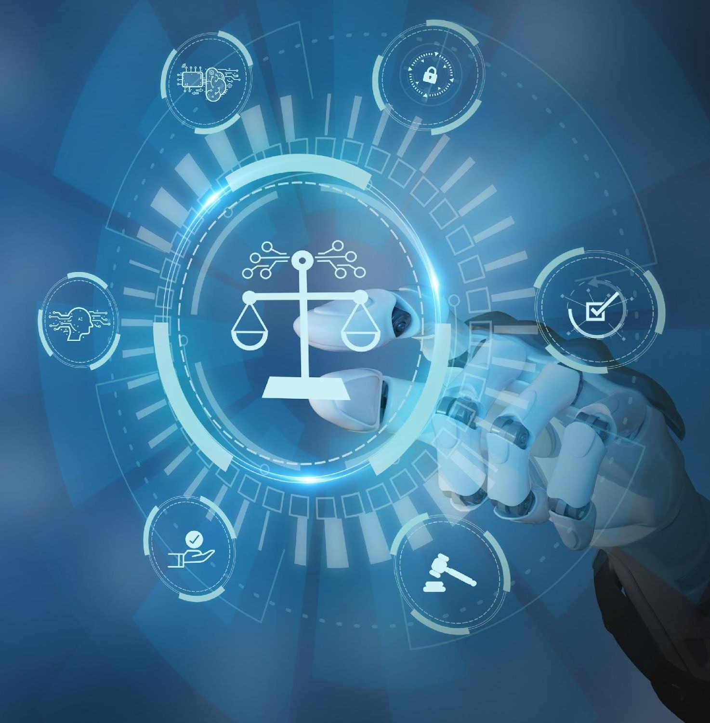
Liability for Infringing Output
If tool is capable of generating infringement, is that enough? Or must there be actual infringement?
The decisions on motions to dismiss in pending cases seem to require actual evidence of infringing output

Slide 18
Liability for Infringing Output
If genAI tool produces infringing output who is liable?
Tool developer? User? Both?
The Supreme Court has held that a technology manufacturer cannot be held liable for its users’ copyright infringement if the technology enables substantial non-infringing uses as well. See, Sony Corp. of America v. Universal City Studios, Inc., 464 U.S. 417 (1984) (Court held that Sony was not liable for contributory infringement for selling video tape recorders to consumers who recorded copyrighted television programs because the video tape recorders had substantial non-infringing uses)

Slide 19
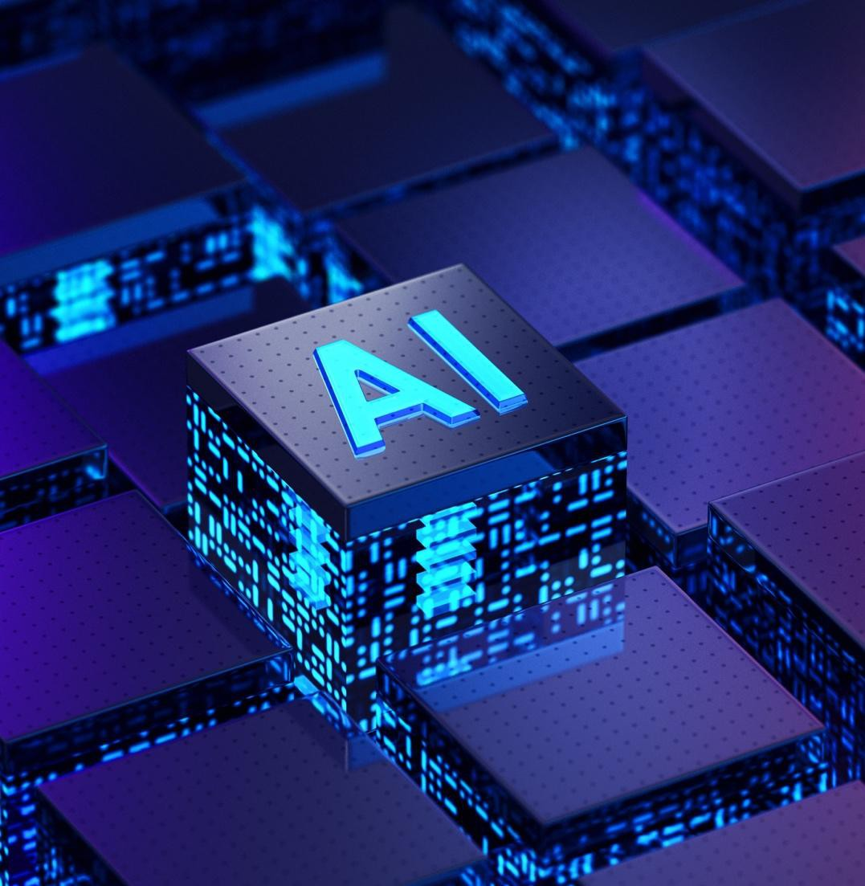
Copyrightability of AI Generated Work
If user inputs prompt that causes AI to generate creative content, can user claim copyright?
Can AI be an author? Joint author?
A “joint work” is a work prepared by two or more authors with the intention that their contributions be merged into inseparable or interdependent parts of a unitary whole

Slide 20

US Copyright Office Guidance
• Published guidance on its policy and practices for examining and registering works that contain material generated by artificial intelligence (AI) technology
• Key points
• Copyright can protect only material that is the product of human creativity
• The term “author,” which is used in both the Constitution and the Copyright Act, excludes non-humans.

Slide 21
US Copyright Office Guidance
Nature of the Elements of Authorship.
The Office will consider whether the AI contributions are the result of “mechanical reproduction” or instead of an author’s own original mental conception, to which the author gave visible form.
The answer will depend on the circumstances, particularly how the AI tool operates and how it was used to create the final work.
This requires looking at the work’s traditional elements of authorship. If these elements were produced by a machine, the work lacks human authorship and the Office will not register it (e.g., when AI technology receives solely a prompt from a human and produces complex written, visual, or musical works in response).
When a work contains AI-generated material but also contains sufficient human authorship to support a copyright claim, copyright will only protect the human-authored aspects of the work, which are “independent of” and do not affect the copyright status of the AI-generated material itself (e.g., a human may select or arrange AI-generated material in a sufficiently creative way that the resulting work as a whole constitutes an original work of authorship or an artist may modify material originally generated by AI technology to such a degree that the modifications meet the standard for copyright protection.).

Slide 22
Practical Advice
Online content is easily scraped by AI.
Register copyrights on all online content.
Needed for enforcement.
Preserves right to statutory damages ($750-$30k per work).

Slide 23
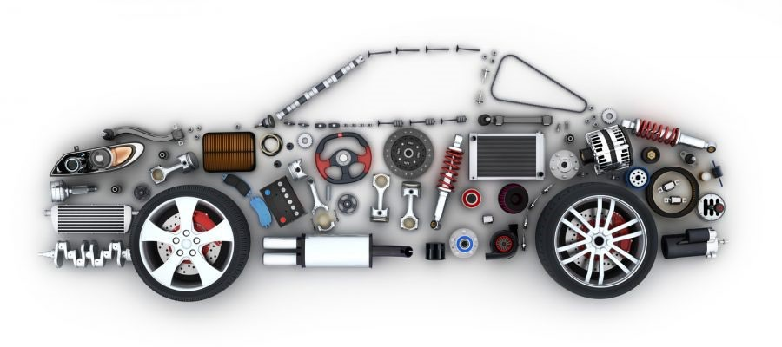
Patents & AI
What is a patent?
Right to exclude others from making, using, offering for sale, selling, or importing a claimed invention for a limited time period
Subject matter: machine, process, article of manufacture, composition of matter
What parts of AI technology can be covered by patents?
Inputs, machinery, and outputs covered by software patents
Often used to cover AI products in the marketplace or internal AI tools

Slide 24
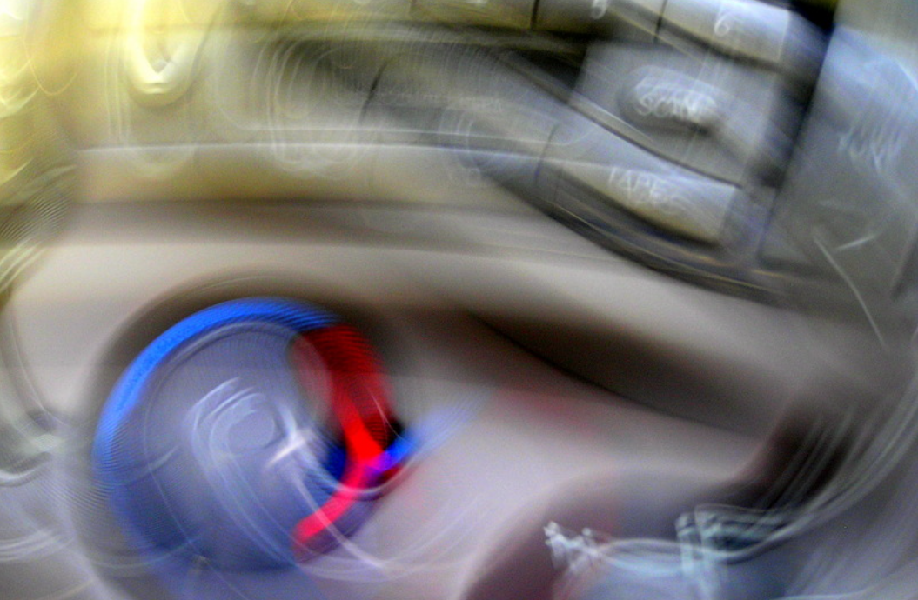
Patents & AI
"Abstract Idea”
Mathematical concepts
Formulas, equations, calculations
Mental processes
Observation, evaluation, judgment, opinion
Certain methods of organizing human activity
Fundamental economic principles, commercial or legal interactions, managing personal behavior or interactions

Slide 25
Patents & AI
To obtain patent protection for AI-related invention, include:
In-depth description of model’s structure
Details of how layers and elements interact throughout the operational structure
Training techniques and algorithms used to arrive at AI outcome
Describe improvements over existing technology or technical field in detail
What problem is being solved?
Must solve a technical problem, not solely devoted to business problems
Give details of how the method improves upon existing computers or other devices
Faster performance, etc.

Slide 26

AI Inventorship
Can AI “invent” new technology?
No, inventor(s) must be human
“AI-assisted” inventions are allowed if there was significant human contribution
To be an inventor, a person must contribute to the “inventive concept” of the invention
Reduction to practice ≠ inventorship

Slide 27
What is “Significant” Human Contribution?
USPTO Guidance:
Merely recognizing a problem or having a research plan to pursue does not rise to the level of conception.
Prompt itself is not enough unless person constructs the prompt in view of a specific problem to elicit a particular solution from the AI system.
Reduction to practice alone is insufficient.
Merely recognizing and appreciating AI output as an invention is not enough without significant contribution to the output.
Person who designs, builds, or trains AI system in view of specific problem to elicit a particular solution could be inventor if the designing, building, or training is a significant contribution to the AI-created invention.
Maintaining “intellectual domination” over the AI system not enough on its own.
Simply owning or overseeing an AI system used in the creation of an invention is not enough without providing a significant contribution to the invention.

Slide 28

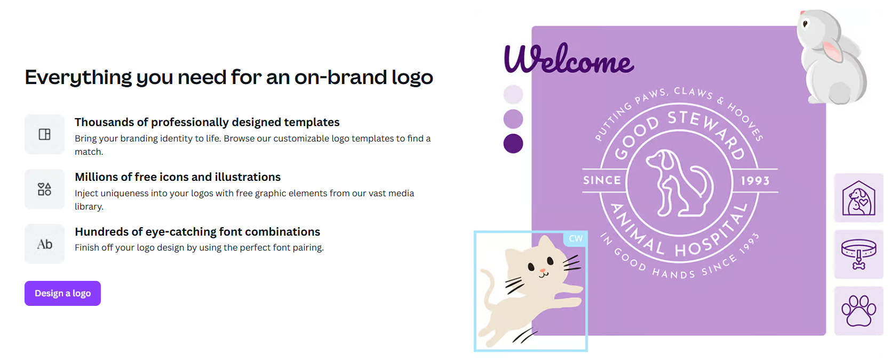
Trademarks & Online Graphic Design Platforms

Slide 29

Trademarks & Online Graphic Design Platforms
Users can share graphics, logos, videos, slideshows, posters, business cards, music, etc.
Terms of use require user attests to having rights in content shared.
Beware of license content!
Prohibited uses: “a trade-mark, design-mark, trade-name, business name, or service mark, whether registered or not.”
Possible future liability if user does not have copyright rights in content.
Graphic design firms also use these tools.

Slide 30
Questions?

