Slide 1
Employment-Based Immigration Matters
Mala Bajpai Esq.
Immigration
Law Office of Mala Bajpai

Slide 2
Disclaimer
ALL INFORMATION PROVIDED TODAY IS STRICTLY INFORMATIONAL AND DOES NOT CONSTITUTE LEGAL ADVICE NOR SHOULD IT BE RELIED UPON.
THERE ARE MANY NUANCES TO EACH INDIVIDUAL CASE AND SITUTATION. TO DELVE INTO A SPECIFIC QUESTION OR MATTER, PLEASE SCHEDULE A PAID CONSULTATION $75/30 MIN

Slide 3


MY IMMIGRANT STORY
In 1960s, my parents came to Arizona.

Slide 4
OVERVIEW
B-1 Visas
F-1 Student & J-1 Visas
H-1B Specialty Workers
TN Visas for Mexico/Canada Nationals in Specific Occupations
E-3/ H1B1/ Guam
L-1 Intracompany Transferees
Green Card/Permanent Residency Processing
Extraordinary Ability
Outstanding Researcher
Multinational Managers
National Interest Waiver
PERM/Labor Certification
Requests for Evidence
Notes:
Navigating the complexities of U.S. immigration law can be daunting, especially when it comes to understanding the various visa categories and paths to permanent residency. The F-1 and J-1 visas are specifically designed for students and exchange visitors, allowing them to engage in academic and cultural programs in the United States. For professionals, the H-1B visa offers a path for specialty workers with specialized knowledge, while the L-1 visa caters to intracompany transferees, facilitating the transfer of employees within multinational companies. The B-1 visa is often utilized for business visitors who need to engage in professional activities temporarily.
For those aiming for permanent residency, the Green Card process can involve several pathways. The Extraordinary Ability and Outstanding Researcher categories are tailored for individuals with exceptional skills and contributions in their fields. Similarly, Multinational Managers can apply for residency based on their executive roles across borders. The National Interest Waiver provides an avenue for individuals whose work benefits the U.S. significantly, bypassing the labor certification process. The PERM process, or Labor Certification, is a prerequisite for certain employment-based Green Cards, ensuring that no qualified U.S. workers are displaced. Throughout these processes, applicants may receive Requests for Evidence, requiring them to provide additional documentation to support their petitions. Understanding these options and requirements is crucial for anyone navigating the U.S. immigration system.

Slide 5
F-1 Student visas
Process:
Gain Admission at a US Institution (High School, Community College, University)
I-20
Apply for F-1 Visa (within the US or Abroad at a Consulate)
Have Requisite Funds
Nonimmigrant Intent

Slide 6
Curricular Practical Training
Training relates directly to the student’s major area of study.
Training is an integral part of the school’s established curriculum.
Designated school official (DSO) authorized CPT in SEVIS, and the authorization prints on the student’s Form I-20.
Occurs before the student’s program end date on the Form I-20.
Authorization is for one specific employer and for a specific period of time.

Slide 7
Curricular Practical Training
Student must secure the training opportunity before CPT can be authorized.
CPT must be authorized before the student can begin work.
Student can have more than one CPT authorization at the same time.
One year of full-time CPT eliminates a student’s eligibility for OPT.

Slide 8
Optional Practical Training
Training relates directly to the student’s major area of study.
DSO recommends OPT in SEVIS.
Student does not have to secure training before the DSO can recommend OPT.
Authorized by the U.S. Citizenship and Immigration Service (USCIS), and the student is issued an Employment Authorization Document (EAD).
Allows the student to work for any employer, as long as the training relates to the student’s major course of study
Can occur before or after the student’s program end date.
Periods of OPT cannot overlap.
Students are eligible for an additional 12 months of OPT authorization, when they change to a higher educational level.

Slide 9
Optional Practical Training
For students engaged in post-secondary schools or at conservatories. Twelve months of Regular OPT is available for each higher level of study. (For example a student may have 12 months for a bachelor’s degree and another 12 months for a master’s degree).
4 Different Variations of OPT:
Pre-Completion OPT: Any portion of OPT used before the student’s Program End Date. It may be part-time or full-time.
Post-Completion OPT: Any portion of OPT used after the student’s Program End Date. It must be full-time.

Slide 10
Optional Practical Training
24-month (STEM) OPT Extension: For students who majored in designated Science, Technology, Engineering, and Math (STEM) degrees approved by DHS. This type of OPT is a 24-month extension of OPT.
Cap-Gap OPT Extension: For students whose prospective employers filed a qualifying H-1B-cap subject petition.

Slide 11
J-1 Visas
Students are eligible to apply for J-1 status only if they meet one of the following criteria:
They are financed by either the U.S. government, or home country government or an international organization
The program is carried out under a written agreement between the U.S. government, foreign government, foreign educational institution or state/local government
Exchange visitor is supported substantially by funding from sources other than personal or family funds

Slide 12
J-1: Home Residency Requirement
Certain J-1 exchange visitors are required to spend two years in their home country at the end of their J-1 program.
J-1 exchange visitors subject to this requirement cannot apply for H, L, or immigrant status unless they either return to their country of nationality for two years or obtain a waiver of the requirement.

Slide 13
2-Year Requirement Waivers
Statement of "No Objection" from your home country.
Interested U.S. government agency.
Persecution.
Exceptional hardship to a U.S. citizen or permanent resident spouse or child.
Request by a designated state department of health. Available only to medical doctors.

Slide 14
H-1B Specialty occupations
Regulatory Authority: 8 CFR §214.2(h)
Jobs which professional workers in a “specialty occupation” is required.
University (bachelors) degree or equivalent
Beneficiary must have a 4-year college/university degree or equivalent experience in the field.
“3 for 1” rule
Credential Evaluations
H-4 Dependents

Slide 15
H-1B Specialty occupations
Six-year limit per person
Can get extensions beyond six-years if:
Candidate has accumulated 365 days in employer-based green card process (1 year extensions), or
I-140 Petition (petition for alien worker) has been approved but immigrant quota is oversubscribed (3-year extensions).
Six-year limit is aggregate of all positions on H-1B (with multiple employers).
Remember: Portability

Slide 16
H-1B Specialty occupations
Fiscal year cap of 65,000
Applies to all new H-1B petitions, with exceptions for institutions of higher education, not-for-profit organizations affiliated with institutions of higher education, and government research organizations.
20,000 additional visas for graduates of U.S. Master’s (or higher) degree programs
Separate quota allocation for nationals of Chile (1,400) and Singapore (5,400)- H-1B1 (see next slide)
H-1B Lottery: March of each year
If selected and approved, cap-subject H-1B’s are valid from Oct.1
Some Petitioners are Cap Exempt

Slide 17
H-1B Cap-exempt Employers
Institutions of higher education: Universities and colleges are examples of cap-exempt employers.
Nonprofit entities affiliated with institutions of higher education: These include nonprofits that are related to or affiliated with universities.
Nonprofit research organizations: These include nonprofits that conduct research.
Government research organizations: These include government-funded research organizations.
For-profit companies (concurrent employment): If the employee will work at an approved nonprofit or qualifying institution.
Existing H-1B visa holders who wish to change employers (AC 21)
Cap-exempt petitions can be submitted throughout the year
Special Circumstances: Chile, Singapore, Australia, Guam

Slide 18
OptIONS IF NOT SELECTED IN H-1B Lottery
OPT/ OPT (3 years for STEM)
Family-Based Options (Covid- AZ/UT Zoom Weddings Acceptable)
F-1 Student Visa (Return to School)
Find a employment with a cap-exempt employer
Institutes of Higher Education
Nonprofits Affiliated with Institutes of Higher Education
Government Research Entities
Newly restored “International Entrepreneur Parole” for Startups
People with a Startup Idea without their own funding
$250,000 from a US Investor or grants of $100,000
Helps with non-treaty countries like India
Form I-941; $1200, biometric fees
Canada
J-1 Visitor Visa through a Department of State sponsorship agency
Self-petition EB1 or O-visa (top of your field)

Slide 19
H-1B Process
Step 1: Prevailing Wage
Before proceeding the Labor Condition Application, you must first get the Prevailing Wage.
Go to O*Net:
Search for job description/job title
Use FLAG Portal:
https://flag.dol.gov/

Slide 20
H-1B Process
Step 2: Labor Condition Application (LCA)
The U.S. employer must guarantee to the Department of Labor in a Labor Condition Application (LCA) that:
The foreign-born professional will be paid at or above the rate paid for a similar position at the employer’s own offices or at those of their local competitors (i.e. prevailing wage or actual wage, whichever is higher);
The foreign worker will not “adversely affect” the working conditions of his or her U.S. colleagues;
U.S. colleagues will be given notice of the foreign worker’s presence among them (10 Day Posted Notice in 2 Conspicuous Locations); and
There is no strike or lockout at the worksite.

Slide 21
LCA Violations
Employers must follow through on these attestations (wage rate, notice, etc.) or they will be in violation of the law and could be subject to civil penalties and pay back wages or be debarred from the H-1B program altogether!
The DOL will begin an investigation of employer practices through both a formal complaint and its own investigation/audit mechanisms.
Public Access File

Slide 22
Step #3: I-129 PETITION
Application is filed to U.S. Citizenship & Immigration Service (U.S. CIS)
Filing Fee for I-129 (varies depending on company size, non-profit status, etc)
Asylum Fee (either nothing, $300 or $600)
$500 Fraud Fee- There is no exemptions to this fee. It is used to “combat fraud” in the H-1B and L-1 categories. 1/3 of the account will be given to the DOS, 1/3 to the DHS and 1/3 to the DOL.
$750 or $1,500 Training Fee- There are exemptions to this fee (e.g. non-profits, institutions of higher education, 2nd extensions), but the training fee for most employers is $1,500. For any employer that has 25 or fewer full-time employees, the fee is $750.
$2,805 Premium Processing Fee (optional) Form I-907 for Premium Processing (optional)
Form I-129H Classification Supplement
Form I-129H-1B Data Collection and Filing Fee Exemption Supplement
G-28 (if attorney representation)
Diploma/Resume/Transcript of Beneficiary and degree evaluation if necessary
Letter from Employer (supporting the application)
Evidence of Maintenance of Status (if beneficiary is present in the U.S.)
Any other Documentation from Employer (brochures, catalogs, website info)

Slide 23
Additional Considerations
USCIS must approve the I-129 before Visa can be issued (at consulate).
Security delays, standard wait times at consul
DS-160 must be submitted online by the applicant
All new H-1Bs (e.g. new graduates, hired from abroad or changing status from one visa to H-1B) are subject to the annual quota.
Change of employer – H-1B petition is filed with paystubs from previous employer.

Slide 24
Derivative family members
Can get visa abroad based on H-1B approval. Status is H-4.
Spouse and children can attend school on H-4.
Spouse can receive employment authorization, but only if:
Principal H-1B worker is the beneficiary of approved I-140; or
The H-1B status has been expanded beyond 6 years based on AC-21
Child will age out at 21 years.
Application for extension is on I-539

Slide 25
L-1 Intracompany transfer
The L-1 Visa is available to:
Executive;
Manager; or
Employee having “specialized knowledge” of a company’s business activities
“coming to the U.S. to provide services in a similar capacity to the same company, a branch office, a subsidiary or an affiliate.”
Candidate must have been employed abroad for at least one year within the previous three years by foreign parent, subsidiary, affiliate or branch office.

Slide 26
L-1 Visa
No annual quota like H-1B
Payroll may be based in U.S. or abroad
L-2 dependent spouses may work
Evidence of Parent/Subsidiary Relationship- One entity must own more than 50% of the shares of the other, and must also be able to control it. This is demonstrated through Articles of Incorporation or Association.
Evidence of Affiliation- Also demonstrated by Incorporation paperwork and other legal documents.
Evidence of Employee working in an executive, managerial or specialized knowledge capacity for the foreign entity at least one year in the past three years.
Specialized knowledge is a higher level of knowledge than can be commonly found within the same type of position in the same industry/company, i.e. proprietary knowledge specifically applicable to the employer’s unique products which also distinguishes the L-1 employee from other employees.

Slide 27
L-1 Time limits
7-year limit for L-1A
5-year limit for L-1B
Unless candidate changes status to H-1B and has accumulated 365 days in employer-based permanent residence process, or when I-140 petition has been approved but immigrant quota is oversubscribed.
Time spent in H or L status with another employer counts toward 5 or 7 year limit
Recapture Time
No quota = unlimited availability
Premium Processing (I-907) is available

Slide 28
PERMANENT GREEN CARD OPTIONS (IMMIGRANT VISAS)
Obtaining an immigrant visa (green card) by securing an offer of permanent employment.
An immigrant visa gives a foreigner the right to permanently live and work in the United States.
Employer sponsorship (labor certification)
Self petition (highly skilled/talented individuals)
For many, the employment-based (EB) method can be a lengthy process. Often for H-1B holders and skilled workers, labor certification from the U.S. Department of Labor is required before proceeding onto the I-140 petition.
The U.S. Government uses quotas and a preference system to allocate these immigrant visas.
Regulatory Authority: 8 CFR §204.5

Slide 29
QUOta system
Worldwide Level- INA §201(d)
Numerical Limitations per country- INA §202
Backlogs: Oversubscription by country/category
See the Visa Bulletin (enclosed in materials)
To be eligible for an available Immigrant Visa, an applicant’s priority date in the particular employment based visa category must be current.
Based on country of birth

Slide 30
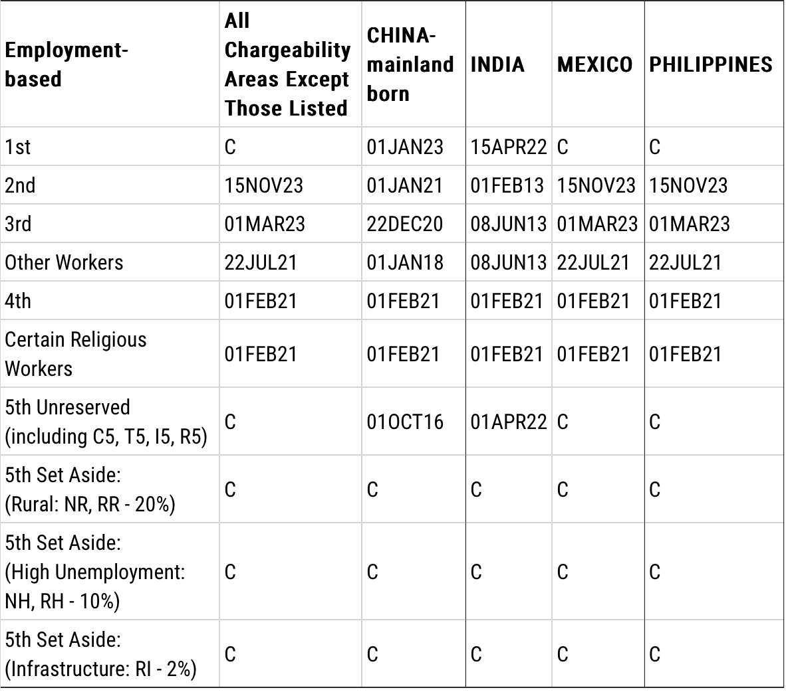
Visa bulletin
June 2025

Slide 31
EB-1: Priority Workers
Labor certification is not required for EB-1's. Priority workers include:
Individuals of extraordinary ability in the arts, sciences, business, education and athletics.
Managers and executives of international companies being transferred permanently to the U.S.
Outstanding professors and researchers.

Slide 32
Extraordinary Ability
Regulatory Authority: 8 CFR §204.5(h)
In order to qualify for this sub-category, an individual must show extraordinary ability in the sciences, arts, education, business or athletics. The petitioner must show a sustained national or international acclaim with recognized achievements. In order to win an EB-1 case the foreigner must submit extensive documentation to back up his/her claim as an individual with extraordinary ability.
The individual needs to show receipt of major internationally recognized award (Nobel Prize) OR
Exhibit at least 3 of 10 criteria listed.
O-1 visa holders might qualify

Slide 33
Extraordinary Ability Criteria
Receipt of lesser nationally or internationally recognized prizes or awards for excellence;
Membership in associations in the field that demand outstanding achievement of their members;
Published material about the foreigner;
Evidence that the foreigner is a judge of the work of others in the field;
Evidence of the foreigners original contributions of major significance to the field;
Authorship of scholarly articles;
Display of the alien's work at artistic exhibitions or showcases;
Evidence the alien has performed in a leading or critical role for organizations that have a distinguished reputation;
Evidence that the alien commands high remuneration in relation to others in the field; or
Evidence of commercial success in the performing arts.
If the above criteria do not apply, the petitioner may submit "other comparable evidence".

Slide 34
Outstanding Professors/Researchers
Regulatory Authority: 8 CFR §204.5(i)
In order to qualify for this sub-category, a foreigner must show international recognition as being outstanding in a specific academic field.
The petitioner must also have a minimum of three years of experience in teaching and/or research in that academic field.
There must be a job offer from a college, university, research institute, or private company.
College or university teachers must be tenured or on a tenure-track.

Slide 35
Outstanding Professors/Researchers: Criteria
The individual must meet at least two of the following criteria:
Receipt of major prizes or awards;
Membership in associations that require outstanding achievements;
Published material in professional journals written by others about the alien's work;
Participation as a judge of the work of others in the same of an allied field;
Original scientific or scholarly research contributions to the field; or
Authorship of scholarly books or articles in scholarly journals with international circulation in the field.

Slide 36
Multinational Managers/Executives
Regulatory Authority: 8 CFR §204.5(j)
L-1A visa holders might qualify
In order to be eligible for priority worker status, a multinational manager or executive must:
Been employed outside the U.S. in a managerial or executive capacity for at least one of the three years immediately preceding the filing of the petition.
The past employment must have been with the same employer, an affiliate, or a subsidiary of the employer.
The foreign worker must be coming to work in an executive or managerial capacity.

Slide 37
EB-2: Advanced Degree Holders & Aliens of Exceptional Ability
Regulatory Authority: 8 CFR §204.5(k)
Advanced degree: Master’s degree or higher
Certified position must require a Master’s or higher degree or foreign equivalent degree
Master’s equivalence = B.A. plus 5 years progressively responsible experience in the field
H-1B holders might qualify

Slide 38
Exceptional Ability
Show that the alien is an alien of exceptional ability in the sciences, arts, or business, petition must prove at least 3 of the following:
An official academic record showing that the alien has a degree, diploma, certificate, or similar award from a college, university, school, or other institution of learning relating to the area of exceptional ability.

Slide 39
Exceptional Ability Criteria (continued)
Evidence in the form of letter(s) from current or former employer(s) showing that the alien has at least 10 years for full-time experience in the occupation for which he or she is being sought;
A license to practice the profession or certification for a particular profession or occupation;
Evidence that the alien has commanded a salary, or other remuneration for services, which demonstrates exceptional ability;
Evidence of membership in professional associations; or
Evidence of recognition for achievements and significant contributions to the industry or field by peers, governmental entities, or professional or business organizations.
If the above standards do not readily apply to the beneficiary’s occupation, the petitioner may submit comparable evidence to establish the beneficiary’s eligibility.

Slide 40
National Interest Waivers
The CIS may exempt the requirement of a job offer, and thus of a labor certification, for aliens of exceptional ability in the sciences, arts or business if exemption would be in the national interest.
To apply for the exemption, the petitioner must submit Form ETA-9089, in duplicate, as well as evidence to support the claim that such exemption would be in the national interest.
Matter of Dhanasar provides that after eligibility for EB-2 classification has been established, USCIS may grant a NIW if the petitioner demonstrates, by a preponderance of the evidence, that:
The foreign national’s proposed endeavor has both substantial merit and national importance.
The foreign national is well positioned to advance the proposed endeavor.
On balance, it would be beneficial to the United States to waive the requirements of a job offer and thus of a labor certification.

Slide 41
PERM (Labor Certification)
Typically, labor certification is a prerequisite for obtaining an employment-based permanent residency. Beneficiaries that fall into the EB-1 category are exempt from this stage of the process.
PERM is the labor certification system that will allow employers to file labor certification petitions online (http://www.plc.doleta.gov).
Employers will not need to submit supporting documentation with the cases and will instead retain all documentation for inspection in the case of an audit.
A percentage of all cases will be flagged for a more extensive supervised recruitment process.

Slide 42
Prevailing Wage Determination
Must get PWD and must be at least 100% of the prevailing wage rate.
File prevailing wage request through the Department of Labor portal - icert. Include job description, minimum requirements, location, other pertinent information, and provide the SOC job code for the proposed position.
The DOL will either agree with your suggested job code or re-categorize the position. DOL will also use a four tier scale for determining prevailing wages based on education, experience, job requirements, etc.

Slide 43
Recruitment under PERM
Within six months prior to filing an application, employers are required to place a job order with the State Workforce Agency and run two newspaper advertisement in Sunday papers.
Employers of professionals are also required to conduct three additional types of recruitment from a supplemental list of recruiting methods. Documentation of recruitment is not to be submitted with the application, but must be maintained in a file that will be available to the DOL in the case of a request by a Certifying Officer or an audit.
Recruitment materials must contain dates of posting and other specific contact details.

Slide 44
Additional Forms of Recruitment
Employers of professionals are required to conduct three additional types of recruitment based on a list of recruiting methods contained in the rule. The acceptable additional recruiting methods for professionals include:
job fairs
employer’s web site
job search website other than the employers
on-campus recruiting
trade or professional organizations
private employment firms
employee referral program with incentives
campus placement offices
local ethnic newspapers
radio and television advertising

Slide 45
Wages in Recruitment
The DOL has dropped the requirement listed in the proposed rules that the wage offer must be included in the advertisement. I
If the 30-day job posting requires the offered wage it cannot simply be the prevailing wage.
If a wage is included in the advertisement, it must be the prevailing wage rate or higher.
If a wage range is included, the bottom of the range must be at least as high as the prevailing wage rate.

Slide 46
Notice of Filing
In addition to recruitment, the employer must prepare and post a notice of filing.
The notice of filing directs any inquiries regarding the labor market test to the Department of Labor.
The notice of filing must contain much more specific information than is required in the advertisement, including detailed contact information, work hours, location, etc. Most of the information in the prevailing wage request can also be used in the notice of filing.
The notice of filing must be posted for 10 business days and the dates of filing must be written on the notice along with the signature of the contact person.

Slide 47
Recruitment Report
Employers are required to document recruiting results in a recruiting report.
Employers under PERM will need to prepare a recruiting report that describes:
recruitment steps undertaken including the dates of each advertisement/posting
Results of recruitment including # of resumes received, interview results = lawful job related reason to disqualify candidates.

Slide 48
Submission of PERM Application
Employer must register with the Department of Labor and create a sub-account for attorneys to file the PERM application electronically.
After the application is filed, the DOL will verify that job offer with a survey via email. If there is no response via email, the DOL will call the employer to verify sponsorship.

Slide 49
PERM Audits
The DOL’s computers will review applications based on various selection criteria that will allow problematic applications to be identified for audit. Also some applications will be randomly selected for auditing.
If an application is selected for auditing, the employer will be notified and required to submit specific documentation to verify the information submitted in the ETA 9089.
Common audits include recruitment documentation or business necessity – where the employer will need to document why minimum requirements are higher than the DOL’s categorical assessment.
The documentation will be reviewed by an ETA official and either certified or, if the application is incomplete of the documentation does not support the ETA 9089,the application will be denied and the employer will be notified of the reasons.
The Certifying Officer also has the option in audited cases of ordering the employer to conduct supervised recruiting.

Slide 50
I-140 Petition (Stage #2)
Once the employer gets an approved Labor Certification, either through the regular process, RIR or PERM, they must file an I-140 petition with the USCIS before expiration.
IMPORTANT: An approved labor certification will expire after 180 days from the date of approval!
Currently the filing fee to the USCIS for this petition is $715.00

Slide 51
I-140 Documentation
Typical supporting documentation that are filed with this petition include:
The approved labor certification (EB-1's and NIW’s are exempt from this).
Letter from employer in support of the petition. The letter explains what the company does, description of the job position, why the prospective employee qualifies for the position (summarizing his/her skills).
Beneficiary’s education credentials (copies of degrees, transcript, awards, honors)
Degree evaluation from a credentialing evaluation service when the degree is from a foreign university.
Affidavits/Letters from former employers demonstrating the individual’s experience/training in the position.
When the petition depends on an offer of employment, it must include evidence of the employer’s ability to pay the stated wage/salary. Thus it is important to submit annual reports, federal tax returns, financial statements. If the employee is already employed by the sponsoring employer, W-2 forms, pay stubs and personal tax returns can also be submitted confirming that he/she already received the offered wage.

Slide 52
I-485 or Consular Processing (Stage #3)
Once the petitioner/beneficiary receive an approved I-140 and they have a current priority date, they can than apply for the “green card”.
To see if their priority date on the I-797 Notice of Approval is current, you should check the Dept. of State website for the visa bulletin. The “green card” application is completed on Form I-485.
Consular processing pertains to an individual who is overseas when the I-140 is approved.

Slide 53
Thank You!
Law Office of Mala Bajpai
602.888.3821
Consultations: $75/30 min
mbklawoffice@gmail.com

