Slide 1

Let’s Talk about S*x Crimes in Arizona
By Jerald J. Schreck
The Schreck Law Firm
jerry@schrecklawfirm.com
(602)370-3262

Slide 2
Sex crimes Topics we will talk about
Sex Crimes Trivia – Who is the Big Cheese?
The Arizona Schreck’s Crimes Sentencing & Registration Chart – The Big Easy
Proposition 313 - The Big Beautiful Bill
Contact Offenses – The Big Three
Non-Contact Offenses – The Big Enchiladas
Cyber Crimes – The Big Screen
Trials – The Big Leagues
Sentencing – The Big House
Recidivism – The Big Lie
Registration – The Big Brother
Great Movie that has nothing to do with Sex Crimes in Arizona - The Big Lewboski

Slide 3
Sex Crimes Trivia – who is the Big Cheese?
?
Notes:
Consider talking about:
Jacob Wetterling Act of 1994
Megan's Law of 1996
Adam Walsh Act of 2006

Slide 4
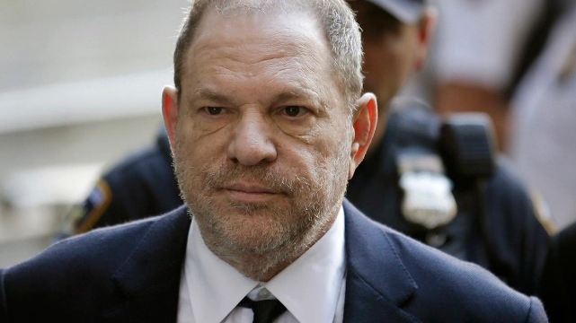
Harvey Weinstein = Accusers >80

Slide 5
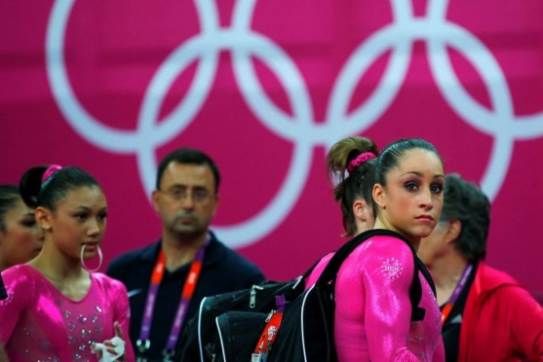
Larry Nassar
“I just signed your death warrant.”
“I wouldn’t send my dogs to you sir.”
“That means in the United States, 400,000 babies born will become victims of child sexual abuse.” “It stops now, Speak out like survivors, become part of the army.”

Slide 6
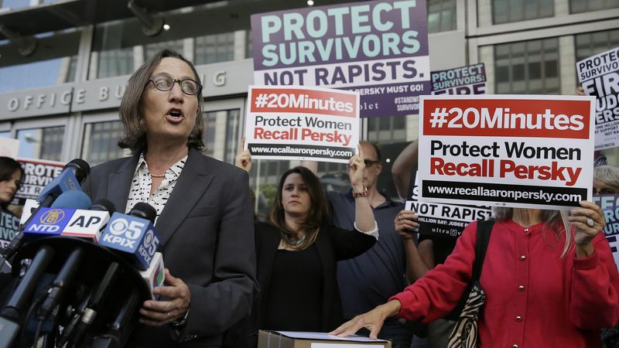
Brock Turner
Jane Doe: “You don’t know me, but you’ve been inside me, and that’s why we’re here today.”

Slide 7

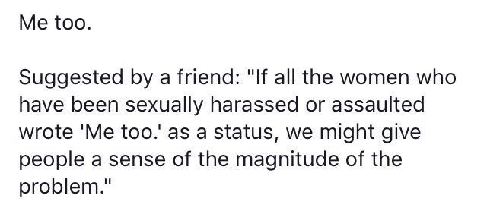
Alyssa Milano

Slide 8
The big Easy
THE “SCHRECK CRIMES”
SENTENCING & Sex Offender Registration Chart
(Last Modified June 17, 2019)
©2003 Jerald Joel Schreck

Slide 9
Contact offenses - The Big Three
Molestation of Child
Sexual Conduct with a Minor
Sexual Assault

Slide 10
Non Contact offenses - The Big Enchiladas
Indecent Exposure
Public Sexual Indecency
Voyeurism

Slide 11
Cyber crimes - The Big screen
Luring a Minor for Sexaul Exploitation
Sexual Exploitation of a Minor
Child Sex Trafficing

Slide 12
Sex Crimes Trials – The Big Leagues
404(c)
Rape Shield
Medical Evidence
General Characteristics Evidence
Computer Evidence

Slide 13

Arizona Sex Crimes Sentencing – the Big House
13-705 DCAC Sentencing Scheme
Fictious Children Provisions
13-3212 Human Trafficking Enhancment
13-1406 Sexual Assault Enhnacments
13-902 (E) Lifetime Probation
13-901(G) Jail increments of 1 year for persons on lifetime probation
The Triple Whammy

Slide 14

Sex Crimes Sentencing In Arizona –The Big House Continued
“Arizona’s sentencing scheme is unique in coupling extraordinary long terms with mandatory stacking requirements, and in requiring each sentenced to be fully survived, without the possibility of early release. The coumpounding impact of this tiple whammy should not escape scrutiny. “ State v. Berger, 212 Arizona 473, 487(Ariz. 2006)(Justice Rebecca Berch).

Slide 15
Sex Crimes - Recidivism & the Supreme Court – The Big Lie
Justice Kennedy – “The risk of recidivism posed by sex offender is frightening and high” McKune v. Lile, 536 U.S. 24,34 (2002) Justice Kennedy).
“When convicted sex offenders reenter society, they are much more liley than any other type of offender to be rearrested for a rape or new sexual assault.” Smith v. Doe 538 U.S. 84 2003) (Justice Kennedy).
Justice Kennedy said the rate of recidivism for untreated sex offenders is 80% and the rate for treated sex offenders is 15%

Slide 16
Sex Crimes - Recidivism & the Supreme Court – The Big Lie
The Recidivism Rate is approximately 3.5 percent.
The Supereme Court’s Crucial Mistake About Sex Crimes Statistics
Ira Ellman Professor at Sandra Day O'Connor School of Law

Slide 17
Sex Offender registration in Arizona – Big Brother
13-3821
Must register w/in 10 days of release from custody
Must register w/in 10 days of moving into an Arizona county from a location outside that county
Must notify the sheriff in writing if you move out of a county you are already registered in
Must notify the sheriff in person and in writing w/in 72 hours if you change your name
Must register w/in 72 hours of changing address w/in a county
Must register every 90 days if you are homeless.
Homeless registrants must give the cross streets where they are living every 90 days when they register
Need to get a new ID/DL every year
Must register w/in 72 hours of moving to a new location from the state of being homeless.

Slide 18
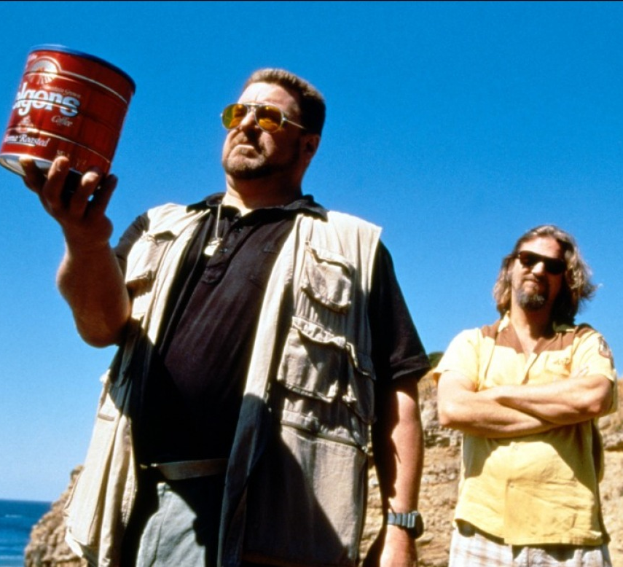
The Big Lebowski
“That rug really tied the room together.”

