Slide 1

Privacy and AI Governance Law

Slide 2
Privacy Protects Personally Identifiable Information (PII) or Personal Data as Defined in Law
Federal Privacy Act of 1974
Information which can be used to distinguish or trace an individual's identity, alone, or when combined with other personal or identifying information which is linked or linkable to a specific individual.
EU General Data Protecion Act (GDPR)
Any information relating to an identified or identifiable natural person; who can be identified, directly or indirectly, in particular by reference to an identifier such as a name, an identification number, location data, an online identifier or to one or more factors specific to the physical, physiological, genetic, mental, economic, cultural or social identity of that natural person. Excludes anonymous data.
California Consumer Privacy Act
Information that identifies, relates to, describes, is reasonably capable of being associated with, or could reasonably be linked, directly or indirectly, with a particular consumer or household. Excludes publicly available information, deidentified information, aggregate information that is deidentified.
Health Insurance Portability and Accountability Act (HIPAA) Protected Health Information
PHI means individually identifiable health information that is (1) created or received by a covered entity (health plan, health care clearinghouse, or health care provider doing electronic transactions as defined in HIPAA) and (2) transmitted or maintained in any form or medium. Excludes education and employment records and PHI of person deceased for 50 years.
Sensitive Personal Data/Special Categories
government IDs; financial account log-in, financial information, precise geolocation, racial or ethnic origin, citizenship, immigration status, religious or philosophical beliefs, union membership, health data, political opinions, genetic or biometric data, sex life, sexual orientation, contents of mail or messages uncles the intended recipient, neural data,

Slide 3
To deidentify or anonymize data, the data must meet privacy law or statistical standards
“[T]he idea of anonymity might be seductive as a mechanism to insure privacy, but it is a subtle and difficult idea to put into practice. Knowing what notion of anonymity is required by regulation is necessary for compliance, but may not be sufficient for the ethical obligations you have as a data steward. Anonymity, Deidentification, and the Accuracy of Data, Harvard Online, https://harvardonline.harvard.edu/blog/anonymity-de-identification-accuracy-data, published August 28, 2023
GDPR
Anonymized Data
Information which does not relate to an identified or identifiable natural person or to personal data rendered anonymous in such a manner that the data subject is not or no longer identifiable.
CCPA
Deidentified Data
Information that cannot reasonably be used to infer information about, or otherwise be linked to, a particular consumer provided that the business that possesses the information: (1) Takes reasonable measures to ensure that the information cannot be associated with a consumer or household. (2) Publicly commits to maintain and use the information in deidentified form and not reidentify (3) Contractually obligates any recipients to comply with all provisions of this subdivision.
HIPAA
Deidentified Data
HIPAA permits two methods: 1. Person with knowledge and experience of statistical methods of deidentification documents the application of principles and methods used until the risk is very small that the information alone or in combination with reasonably available information by the recipient could identify the individual; or 2. Safeguard Method of eliminating 18 identifiers of individual and individual’s employer and family and there is no actual knowledge that the individual could be reidentified

Slide 4
Privacy Principles are Foundation of Privacy Laws and Governance
Collection Limitation - limit to lawful and fair collection (consent)
Purpose Specification – purpose specified at collection and limited to purpose
Data Quality – data should be relevant and necessary, accurate, complete, up-to-date
Use Limitation – not used or disclosed except for the specified purpose, unless authorized by law or consent
Security Safeguards – protect with reasonable security safeguards to protect confidentiality, integrity, and availability
Transparency Principle - openness about practices and policies respecting data
Individual Participation Principle – rights to notification, access, amendment/rectification, appeal, etc.
Accountability Principle – data controller accountable to effect principles

Slide 5
Privacy and Security are Not the Same
Privacy
Focus on Authority to Collect, Use, and Disclose PII and Controls to Limit to Authorized Purpose
Individual Rights for Notification of Purpose and to Access, Amend, Object, Delete, Portability, Appeal
Security
Focus on Protecting Confidentiality, Integrity, and Availability through Administrative, Physical, and Technical Controls
Manages Risk with Controls in Each Security Core Function: Govern; Identify; Protect; Detect; Respond; Recover
Conflict with Security: Privacy determines the right to access data based on authority to use data for that specific purpose; Sensitive health data may only be viewed by the group health plan team regardless of role
Example: Security determines access based on role; such as Senior Vice Presidents may access any corporate sensitive health data

Slide 6
United States Privacy Governance and Sectoral Laws
Federal Agencies
Privacy Act of 1974
Breach Notification Lws
Financial
Biometric Data
Surveillance
Marketing
Employment
Health
FISMA
Agency Regulations
Drivers Privacy Protection Act
E-Government Act
All states have laws
Telecommunications
Children and Education
GLBA
Federal Credit Reporting Act (FCRA) amended by Fair and Accurate Credit Transactions Act
Right to Financial Privacy Act
Telecommunications Act 1996
Electronic Communications Privacy Act
Cable Communications Policy Act
Health Insurance Portability and Accountability Act (HIPAA)
Health Information Technology for Clinical and Economic Health Act (HITECH)
Genetic Information Nondiscrimination Act
Washington State My Health My Data Act
State Consumer Privacy Laws
Nevada SB 370
State financial privacy laws
American Disability Act
HIPAA – Group health plans
FCRA
CCPA and other state laws related to processing non-employment data
State AI Privacy Laws – limit automated processing without human intervention
Illinois, TX, Washington, Colorado
State Biometric Privacy Laws
Restrict the collection and use of biometric data without consent
Restrict retention of biometric data
Controlling the Assault of Non-Solicited Pornography and Marketing Act (CANSPAM)
Reforming Intelligence and Securing America Act
State Privacy Acts – i.e. California Invasion of Privacy Act
Privacy Protection Act
State Laws on Recording
Federal Information Surveillance Act
USA Freedom Act
Telephone Consumer Protection Act
Tort and Statutory Laws on Use of images and voice recordings
State Consumer Privacy Laws
Robocall
Data Brokers
Childrens’ Online Privacy Protection Act
State Consumer Privacy Laws
Family Educational Rights and Privacy Act
Protecting America’s Data from Foreign Adversaries
FCRA
State Consumer Privacy Laws
State Data Broker Laws (CA, Oregon, Texas, VT)
FTC Health Breach Notification Rule
HIPAA Breach Notification Rule
Gramm Leach Bliley Act (GLBA) Safeguards Rule
Consumer Privacy Laws
Federal Trade Commission Act – FTC has been biggest regulator of privacy
20 State Consumer Privacy Law
Regulate businesses
Protect state residents acting in personal and household manner; CA exception

Slide 7
Similar to Privacy Laws, AI Laws Include AI Governance and Sectoral Laws
Governance Laws
CA, CO, UT, TX
Sectoral AI Laws
Employment:
FTC Regulations – Unfair and Deceptive Practices Act
Governance – program and documentation, risk assessments, training, responsible individual
Transparency – notice (data used or algorithm, explanation), incident reporting, developer documentation, detection tool
Assurance – Third party review, registration
Individual Rights – Opt-out/appeal, nondiscrimination
CA – Prohibition on digital image without estate consent
CA – Prohibits term in agreement for digital replica in lieu of individual’s work
Health and Insurance
AZ – insurance medical directors must review denials based on medical necessity
BOTS or Communication Tools
Prohibition on deceptive media or need for notice
Notice required on election ads
CA - Prohibited from incentivizing a sale or influencing vote without disclosing it’s a bot
CA – Must disclose AI generated or altered ads
CA – Sellers of AI that makes synthetic content must include warning of civil or criminal liability for misuse
CA - large online platforms must remove or label deceptive and digitally altered or created content related to
CA - Disclaimers on AI medical communications; prohibition on implying licensed care
CO - law applies to insurers’ use of external consumer data and information sources (ECDIS), as well as algorithms and predictive models that use ECDIS in “insurance practices,” that “unfairly discriminate”
Children
CA - Prohibits chatbots from increasing engagement, use, or response rates; must display it’s AI
Real Estate
CA - Brokers and Salespersons must disclose digitally altered images
Election AI Laws
State Privacy Laws—Many provide rights to contest automated decision making without human intervention, right to notification of method for decision making, right to appeal

Slide 8

How Does Privacy and AI Governance Apply to My Practice and Clients
Website Marketing – Depending on state where offering services and goods (currently bill for AZ Consumer Privacy Act) need accurate privacy policy, opt-outs, opt-ins, etc. and must comply with AI laws on chatbots or other AI tools
Consumer Privacy Acts - Clients or Firm collecting PI of Consumers (website visitors or CA employees) in any state with Consumer Privacy Act
Employment – Applicant information from CA; group health plan data; ADA collected data, FCRA checks; recording meetings (AI or otherwise); help desk or consumer answering tools
Photos/Voice Recordings for Marketing – Besides IP requirements, need to ensure documented individual consent for commercial use
Data Privacy Agreements – Agreements where PI is collected or received if type of data protected or data subjects reside in states with privacy laws or vendor is providing PI; Includes legal SaaS Providers
Clients Who Develop or Deploy AI – privacy and AI laws may apply
Vendor Contracts– AI and privacy laws may apply
SaaS Tools Used in Firm – Implicate ethical obligations and privacy laws
Corporate Clients in Industries with Privacy or AI laws
Personal Data Collection, Purchase, Use, or Disclosure for Commercial Development – Besides IP requirements, must ensure legally authorized collection, use, or disclosure of personal data
Health and Research Clients – Numerous privacy laws
Litigation – Online tracking technologies, biometric data collection, breach, discrimination, NIL, contract breach, privacy torts, marketing, FCRA, recording

Slide 9
Software as a Service (SaaS) Products, including AI Tools, Impact Ethical Obligations
U.S. v. Heppner, S.D. New York
Ethical Rules Implicated
Client put attorney info from attorney into AI LLM Claude
Westlaw Terms
Document Intelligence Terms: Customer acknowledges that, given the machine learning nature of our Service, Thomson Reuters may use Your Content to train, update, modify, and adapt its products (“Machine Learning Adaptions”). Customer agrees that any Machine Learning Adaptions resulting from the use of Your Content, including any updates, enhancements or derivative works arising from the Machine Learning Adaptions, shall be considered solely Thomson Reuters property, and Customer grants Thomson Reuters a royalty free, non-exclusive, irrevocable, and perpetual license to Your Content as necessary to ensure Thomson Reuters rights to the Machine Learning Adaptions.
General Terms: Your Data may be used as an input for certain Artificial Intelligence (“AI”)-based functionality within our Services (“Input”) resulting in an output generated by the AI service (“Output”). You grant Thomson Reuters a license to use, modify, and adapt the Input as necessary for Thomson Reuters to perform, and improve our Services. Thomson Reuters retains all rights to anyof the Property embedded in, or included with any Output, including any derivatives, or modifications thereto.
CLiO Legal Platform
Limited License and Use of Service: Subscriber grants to Themis a non-exclusive, worldwide, sublicensable, royalty-free right to use, store, modify, transmit, collect, and otherwise process the Content and Confidential Information for the sole purpose of providing the Service, performing Themis’ obligations and exercising Themis’ rights under the Agreement in accordance with the terms of the Agreement. Such rights shall include permission for Themis to, in perpetuity, generate and publish aggregate, anonymized reports on system usage and Content trends and type, provided they do not conflict with [confidentiality terms].
Confidentiality: Themis and any third party vendors and hosting partners it utilizes to provide the Service shall hold Content in strict confidence and shall not use or disclose Content except (a) as required to perform their obligations or exercise their rights under this Agreement; (b) in compliance with Section 7 of this Agreement, or (c) as otherwise authorized by you in writing.
Why Privileged Failed
AI is not a lawyer
Not for obtaining legal guidance (tools terms disclaimed it provided legal guidance)
Big One—not confidential (tools terms said not confidential; used for training; tools terms claim right to disclose to government
Pre-existing documents can’t be cloaked in privilege
Created by client not attorney
GenAI: Subject to the use restrictions set forth in the Agreement and to the extent permitted by applicable law, as between you and us,you own the Output generated from your use of the GenAI Skills, provided that such ownership is subject to our third-party licensors’ rights and any rights we retain in our Property or any derivatives thereof.
AI tools are not protected by attorney client or work product privilege
U.S. v. Heppner, S.D. New York
E.R. 1.6, Confidentiality
E.R. 1.1 Competence
E.R. 1.3 Diligence
E.R. 5.1, 5.2, 5.3 Duties to Supervise Lawyers and Nonlawyers
E.R. 1.2 Scope of Representation and Allocation of Authority between Client and Attorney
E.R. 1.5 Fees
E.R. 3.1 and 3.3 Meritorious Claims and Candor to the Tribunal
Legal Compliance: Themis reserves the right to provide the Confidential Information to third parties as required and permitted by law (such as in response to a subpoena or court order), and to cooperate with law enforcement authorities in the investigation of any criminal or civil matter.

Slide 10
Tracking Technologies are Used to Collect Personal Data and Sensitive Data to Profile Individuals for Ads and to Sell Profiles
Cookies (defined by party, duration, specialization)--remember information about your visit; record login details, language preferences, etc.; crucial to experience; 3rd party track behavior across websites
Pixels (images embedded in a website or email) (data files stored on your device)—analytics (geolocations, device type), retargeting (send reminders to potential customers), conversion (track customers after action/purchase)
Beacons or tags (snippets of code stored in HTML or language used to create websites)—collect data about interactions on site; analytics for advertising
Probabilistic methods and keyloggers (fingerprinting and identity graphs and keystroke inputs)

Slide 11
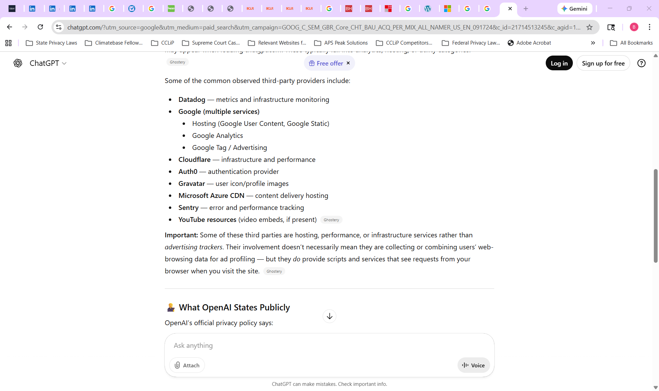

Slide 12
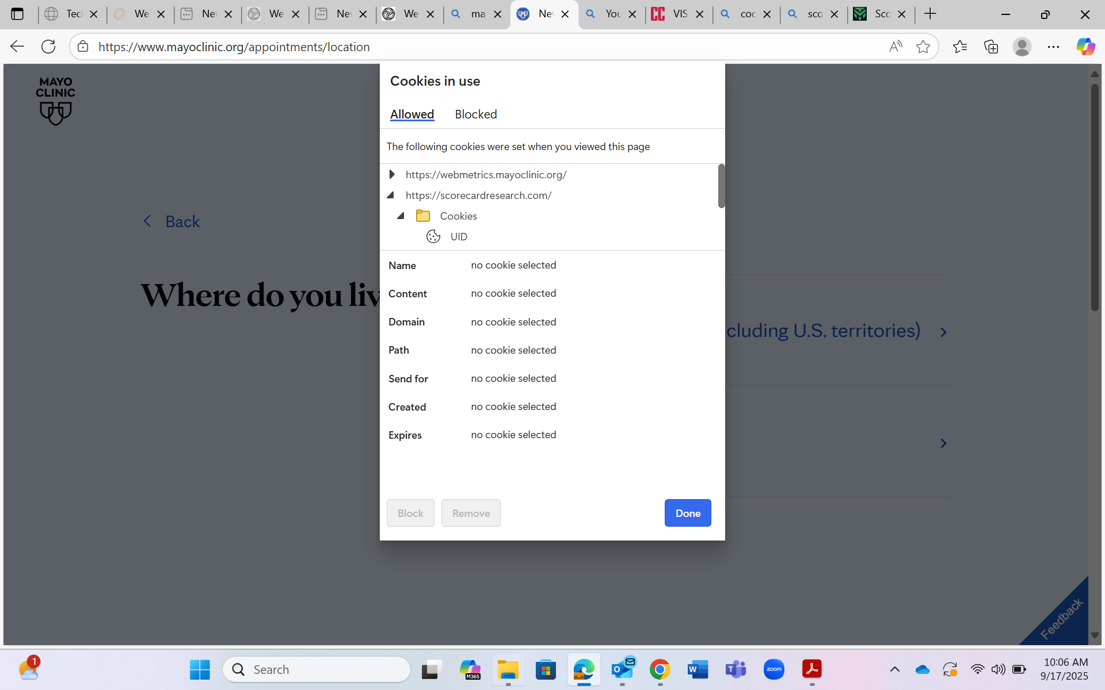

Slide 13
