Slide 1
Using the 7 Deadly Sins
In Your Law Practice
Gregory J. Larson
Hyung S. Choi
January 23, 2026
Chernoff’s Lawyers In Limine

Slide 2


Slide 3
What’s in the Box?!
Rules, not in this order: ER 1.1 Competence; ER 1.3 Diligence; ER 1.4 Communication; ER 1.8 Conflict of Interest; ER 2.1 Advisor; AZ ST S CT Rule 34
Pride: When Ego Replaces Judgment
Envy: When Comparison Replaces Strategy
Wrath: When Anger Takes Over
Lust: When Desire Overrides Judgment (do we really have to discuss this?)
Sloth: When Inaction Becomes Failure of Advocacy
Greed: When “More” Replaces “Better”
Gluttony: When Overindulgence Undermines Persuasion

Slide 4
Ethics Rule 2.1
ER 2.1. Advisor
In representing a client, a lawyer shall exercise independent professional judgment and render candid advice. In rendering advice, a lawyer may refer not only to law but to other considerations such as moral, economic, social and political factors, that may be relevant to the client's situation.
Comment
Scope of Advice
[1] A client is entitled to straightforward advice expressing the lawyer's honest assessment. Legal advice often involves unpleasant facts and alternatives that a client may be disinclined to confront. In presenting advice, a lawyer endeavors to sustain the client's morale and may put advice in as acceptable a form as honesty permits. However, a lawyer should not be deterred from giving candid advice by the prospect that the advice will be unpalatable to the client.

Slide 5
Ethics Rule 2.1
Comment
Scope of Advice
[2] Advice couched in narrowly legal terms may be of little value to a client, especially where practical considerations, such as cost or effects on other people, are predominant. Purely technical legal advice, therefore, can sometimes be inadequate. It is proper for a lawyer to refer to relevant moral and ethical considerations in giving advice. Although a lawyer is not a moral advisor as such, moral and ethical considerations impinge upon most legal questions and may decisively influence how the law will be applied.

Slide 6
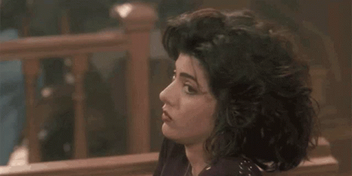
Ethics Rule 2.1
Comment
Scope of Advice
[3] A client may expressly or impliedly ask the lawyer for purely technical advice. When such a request is made by a client experienced in legal matters, the lawyer may accept it at face value. When such a request is made by a client inexperienced in legal matters, however, the lawyer's responsibility as advisor may include indicating that more may be involved than strictly legal considerations.

Slide 7
Ethics Rule 2.1
Comment
Scope of Advice
[4] Matters that go beyond strictly legal questions may also be in the domain of another profession. Family matters can involve problems within the professional competence of psychiatry, clinical psychology or social work; business matters can involve problems within the competence of the accounting profession or of financial specialists. Where consultation with a professional in another field is itself something a competent lawyer would recommend, the lawyer should make such a recommendation. At the same time, a lawyer's advice at its best often consists of recommending a course of action in the face of conflicting recommendations of experts.

Slide 8
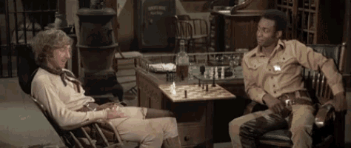
Arizona State Supreme Court Rule 34
“No applicant will be recommended for admission to the practice of law in Arizona by the Committee on Character and Fitness unless the Committee is satisfied that:
. . . the applicant is mentally, emotionally and physically able to engage in the practice of law, and possesses the required knowledge of the law to do so; . . .”
AZ ST S CT Rule 34(b)(1)(C)

Slide 9

Ethics Rule 1.1 Competence
ER 1.1. Competence
A lawyer shall provide competent representation to a client. Competent representation requires the legal knowledge, skill, thoroughness and preparation reasonably necessary for the representation.

Slide 10
Ethics Rule 1.3 Diligence
ER 1.3. Diligence
The Standard
A lawyer shall act with reasonable diligence and promptness in representing a client.
The Limitation
A lawyer is not bound to press for every advantage. A lawyer may have authority to exercise professional discretion in determining the means by which a matter should be pursued, ER 1.2, and should not use offensive or disrespectful tactics in carrying out the representation. In fact, a lawyer should advise the client that the lawyer plans to treat all others with civility and courtesy, including opposing counsel, the court and third parties, and that this approach should not be equated with weakness.

Slide 11

Topic Transition

Slide 12

1. Pride: When Ego Replaces Judgment
Hubris, arrogance, pretension, dangerous overconfidence and complacency

Slide 13
1. Pride: When Ego Replaces Judgment
The SINS
How pride shows up in litigation
  Refusal to reassess weak positions
  Escalation of illogical or indefensible arguments
Why pride fails
  Each added layer becomes less legitimate and harder to defend
Unchecked pride fuels conflict
  Recognizing this dynamic helps manage clients and opponents, and stay outcome-focused
The VIRTUES
Confidence and humility outperform pride
  Acknowledging opposing arguments strengthens credibility and logic
Humble confidence persuades
  Clear-eyed, disciplined advocacy is more effective

Slide 14

2. Envy: When Comparison Replaces Strategy
Sad or resentful covetousness towards the traits or possessions of another person

Slide 15
2. Envy: When Comparison Replaces Strategy
The SINS
Envy distorts judgment
  Focus shifts to others’ status or success
Emotion replaces strategy
  Envy-driven decisions are reactive, unstable, and lack reason
Loss of control
  Fixation on others’ circumstances leads to poor, self-defeating choices
Resentment toward another’s success has no value
The VIRTUES
Law over emotion: Benevolence allows rules, procedure, and logic to guide strategy

Slide 16



3. Wrath: When Anger Takes Over
Anger, Rage, Hate
During
After
Before

Slide 17
3. Wrath: When Anger Takes Over
The SINS
How wrath shows up:
  Wastes resources on punishment rather than resolution
  Hatred drives reckless accusations that lacks clarity and credibility
Litigation becomes a tool to harm rather than resolve disputes
Anger encourages delay and obstruction instead of progress
The VIRTUES
Patience counters wrath
  Calm, deliberate action neutralizes emotionally driven attacks
  Allows preparation, clarity, and effective rebuttal

Slide 18
4. Lust: When Desire Overrides Judgment
The SINS
An intense, unbridled longing
ER 1.8(j): A lawyer shall not have sexual relations with a client, unless . . .
The VIRTUES
Indifference over impulse: Emotional detachment preserves focus and stability
Discipline prevents downfall: Resisting desire protects what matters most
  Commit to the objective, not the fantasy

Slide 19

5. Sloth: When Inaction Becomes Failure of Advocacy
Laziness, Idleness, Indolence

Slide 20
5. Sloth: When Inaction Becomes Failure of Advocacy
The SINS
Sloth kills outcomes
  Inaction leads to missed deadlines and weakened cases
  Late filings, poor records, and lack of candor damage credibility
Lazy arguments fail pathos, ethos, and logos
The VIRTUES
Diligence builds authority
  Follow-through and perseverance strengthen an advocate’s position
Reliability distinguishes leaders
  Timeliness, preparation, and responsiveness set lawyers and clients apart

Slide 21

6. Greed: When “More” Replaces “Better”
Treachery, fraud, deceit, perjury, restlessness, violence and hardnesses of the heart against compassion.

Slide 22
6. Greed: When “More” Replaces “Better”
The SINS
Greed distorts priorities
  Endless accumulation replaces focus on the best litigation outcome
Unpredictable behavior
  Decisions become detached from strategy or reason
Repeated success can fuel unrealistic, greedy expectations
Greed pulls attention away from what actually matters
The VIRTUES
Gratitude restores balance
  Satisfaction and perspective support wiser, more productive behavior

Slide 23
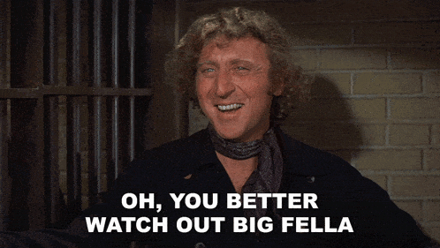
7. Gluttony: When Excuses Undermine Persuasion
Overindulgence and overconsumption to the point of excess

Slide 24
7. Gluttony: When Overindulgence Undermines Persuasion
The SINS
Diminished effectiveness and satisfaction
Lawyers can unintentionally foster unrealistic expectations
Excess weakens strategy rather than strengthening it
The VIRTUES
Balance persuades
  Effective advocacy blends
Moderation builds credibility
Restraint outperforms excess

Slide 25
Some Reflections
Irrational behavior in law can be predictable when viewed through human motives
Identifying destructive patterns creates distance, clarity, and strategy
The sins explain conduct; the virtues guide response
Credibility, not combat, wins judges, juries, and negotiations
Lawyers lead best by modeling restraint, discipline, and perspective
Effective advocacy keeps clients out of the mud—and focused on outcomes

Slide 26
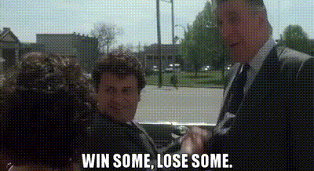
Suggestions
Helpful use of Psychopathic Tendencies
R.A.C.F.M.F.M.
Ruthless
Active
Charming
Fearless
Mentally Tough
Focused
Mindful

Slide 27

Suggestions
Wisdom of Psychopaths What Saints, Spies, and Serial Killers Can Teach Us About Success, By: Kevin Dutton
Breath The New Science of a Lost Art, By: James Nestor
Se7en Motion Picture, 1995
Blazing Saddles Motion Picture, 1974
Wolf on Wall Street Motion Picture, 2013
My Cousin Vinny Motion Picture, 1992
Best Practices State Bar of Arizona Best Practices (Under the Ethics Heading Next to the Rules)

Slide 28
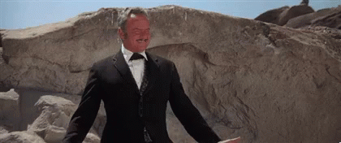
The End

